Slide 1
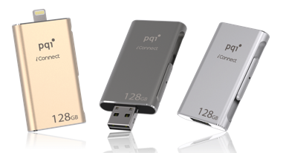
PQI Confidential & Property
Date: June 2015
Notes:
Today, I would like to share PQI iStorage product marketing and product plan with Steve.

Slide 2
Agenda
APPLE i-Device Trend Analysis
iConnect Marketing
iConnect Product Position
iStorage Product Roadmap Plan

Slide 3
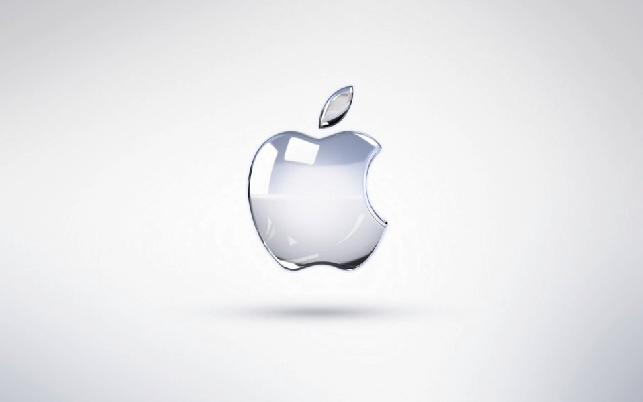
APPLE i-Device Trend Analysis

Slide 4
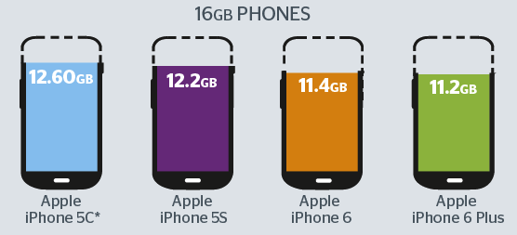
How much storage space does iPhone really have?
iOS 8.1.3 occupy iPhone 4.7GB
Notes:
iOS occupy Phone 4.7GB and that’s mean we just only really have around 11GB for APP download and all audio/Video we take.

Slide 5
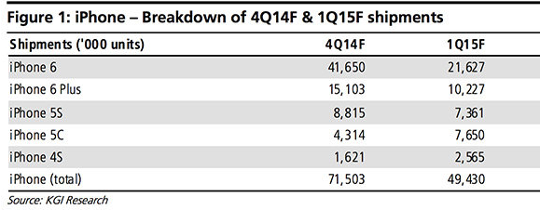
TAM (Total Available Market)
User Demand:
iPhone 4Q14-1Q15(F) shipment 120Mpcs, 16GB 45% ,50-60Mpcs.

Slide 6
iPhone sales by region
- Region sales:
USA 40.9%, EU 22.8%,Great China 21.6% (China/TW/HK), Japan 7.4%, Rest of Asia Pacific 7%
40.9%
22.8%
21.6%
7.4 %
7.0%
6
http://forums.appleinsider.com/t/184535/china-responsible-for-massive-apple-revenue-growth-reaches-16-1b-in-q1

Slide 7
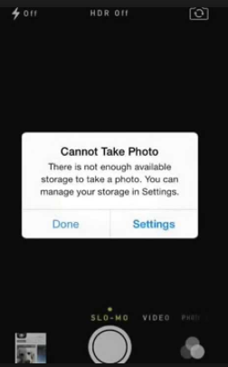
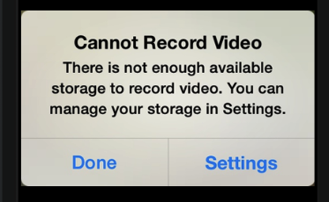
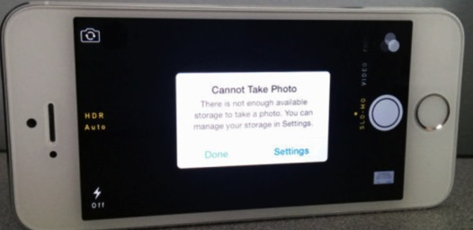
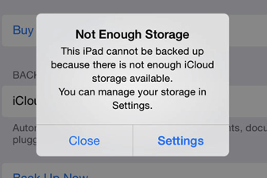
Cannot Record Video!!
But iPhone, iPad or iPod touch Ran Out of Storage Space ?
Notes:
There are so many user complains we hear from internet forum and Apple store, 16GB users don’t have enough space to store their photo and video.

Slide 8
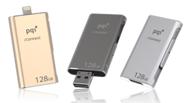
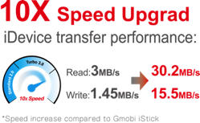
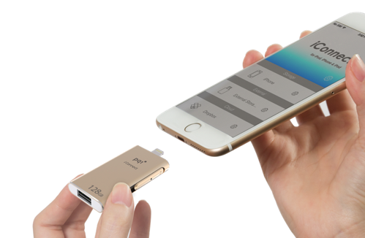
Get More Space for Your iPhone and iPad
The World Fastest
～iConnect extreme high-speed dual flash drive, advanced efficiency, the world’s No.1 transferring speed
Feature：
Free up space
Two-way high-speed data transfer
Lightning read/write speed: 30/15 MB/s;
USB 3.0 read/write speed: 95/25 MB/s
Watch movie and play music anywhere, anytime
File encryption ＆ File compression
Interface：Apple MFi Certified Lightning Interface & Standard USB3.0
Capacity：16GB / 32GB / 64GB / 128GB
OS Supported： Windows Vista, Windows 7, Windows 8,
Mac OS X v10.6+
Dimensions：54.2 x 31.3 x 8.3 mm
Weight：21g
Warranty：2 Years
Compatibility：iPhone 6 Plus, iPhone 6, iPhone 5s, iPhone 5c, iPhone 5, iPad Air 2,iPad Air, iPad (4th generation), iPad mini 3, iPad mini2, iPad mini, iPod touch (5th generation) and newer (iOS 7.1+)

Slide 9
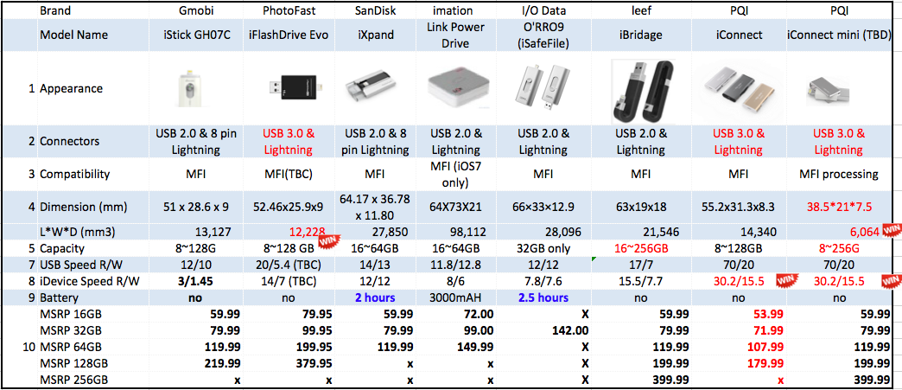
Right Product Specification

Slide 10
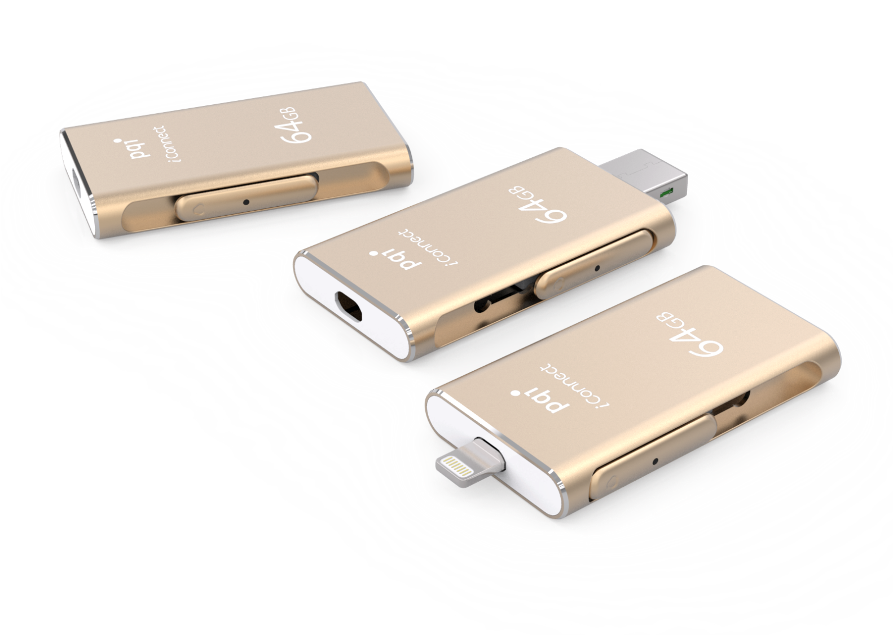

Slide 11
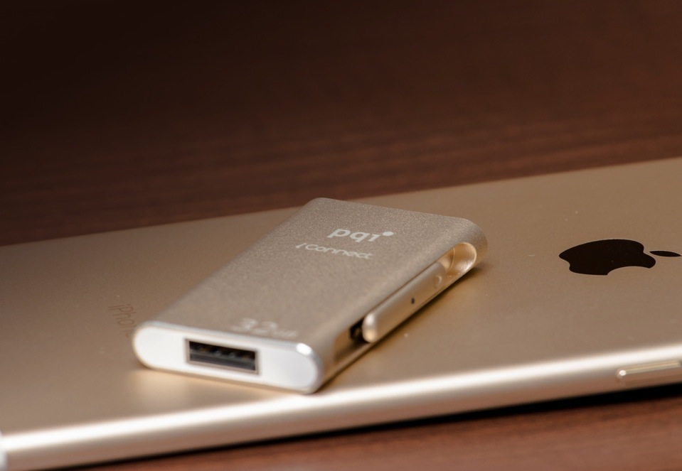
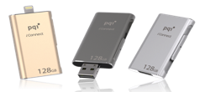
Made for iPhone, iPad & iPod

Slide 12
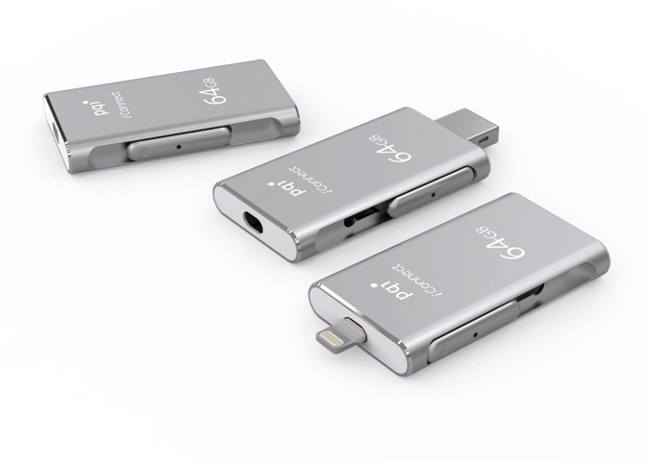

Slide 13
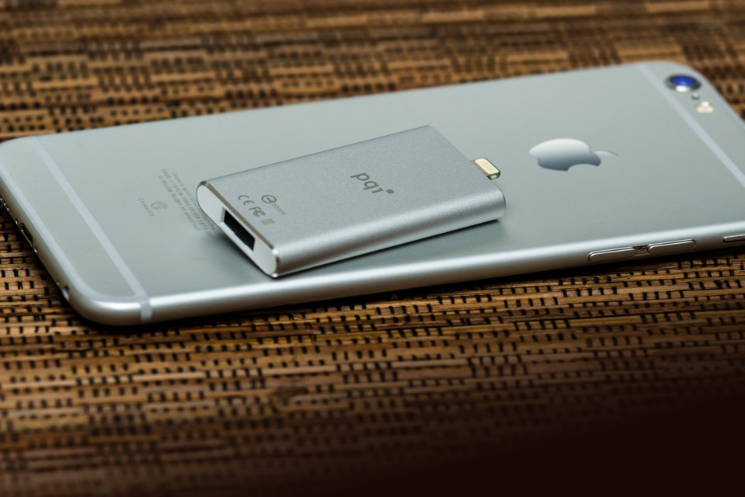
Made for iPhone, iPad & iPod

Slide 14
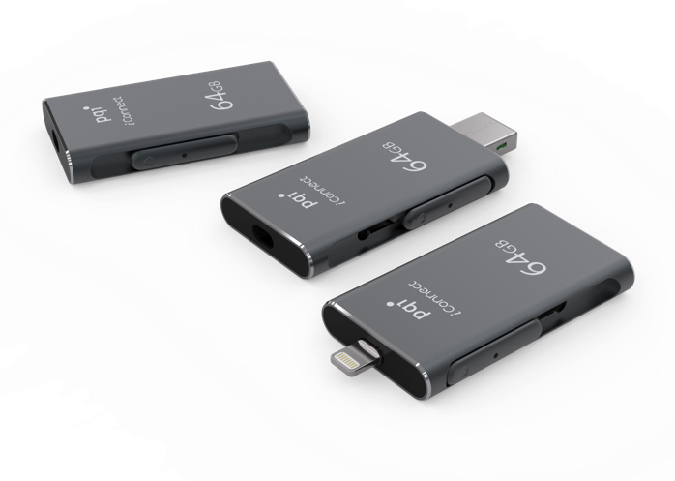

Slide 15
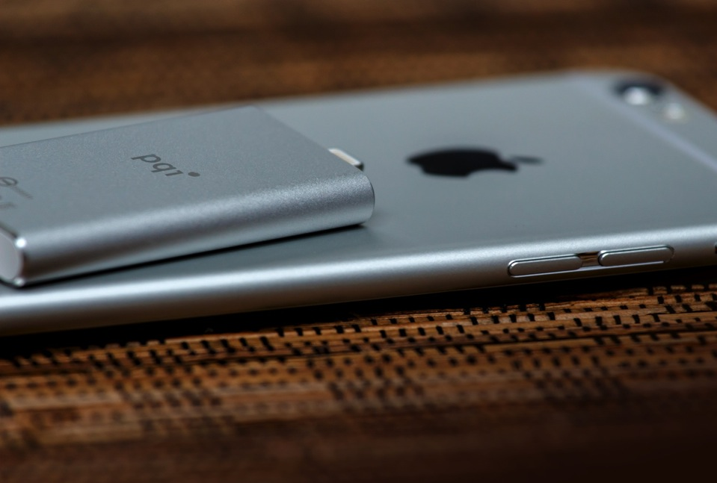
Made for iPhone, iPad & iPod

Slide 16
Get More Space for your iPhone, iPad & iPod
Free Up your iphone Space
Watch Movie any thing, any where, anytime
1080p HD movie streaming, direct playback from iConnect
No built-in battery - no need to charge iConnect，Low power design
fastest read/write speed - Lightning read/write speed: 30/15 MB/s; USB 3.0 read/write speed: 95/25 MB/s.
Slider Design with Aluminum material design
Lightning / USB 3.0 dual-interface
Free universal iOS app for iPhone/iPad/iPod touch
Safe & Secure since no Internet access, your data is never sent through 3rd party servers
Data Security with pass word function.

Slide 17
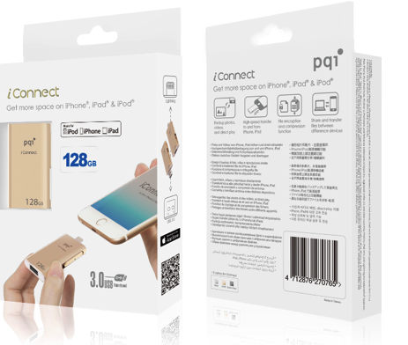
Product Info.
Package
Dimension: 173x109x25 mm
Weight: 71.9g
30pcs / carton

Slide 18
iStorage Roadmap
MP in Q3

Slide 19
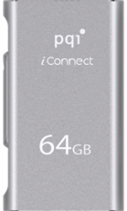
iConnect mini: iConnect= 33%:1
iConnect mini : 45x15x7 = 4,725 mm³
iConnect : 55.2 x 31.3 x 8.3 = 14,340 mm³
T: 8.30 mm
T: 7 mm
45 mm
55.2 mm
15 mm
31.3 mm
mini
iConnect

