Slide 1
for Apple
Specialist for Apple Accessories from iPhone, iPad to MacBook

Slide 2
Why choose PQI for Apple accessories?
Choose 1 PQI and get ALL Apple accessories
We provide full product lines for Apple accessories
From lightning cable, Power bank to OTG storage for iOS
All products with Apple license
Joined Foxlink group in 2010, which is Apple OEM factory
With strong support from Foxlink we have bigger advantages on Apple products.
Create for convenience
Provide more kinds of products to make technology closer to life

Slide 3
Foxlink Group
Chairman: T.C. Guo
Brother company of Foxconn
Apple’s OEM manufacture

Slide 4
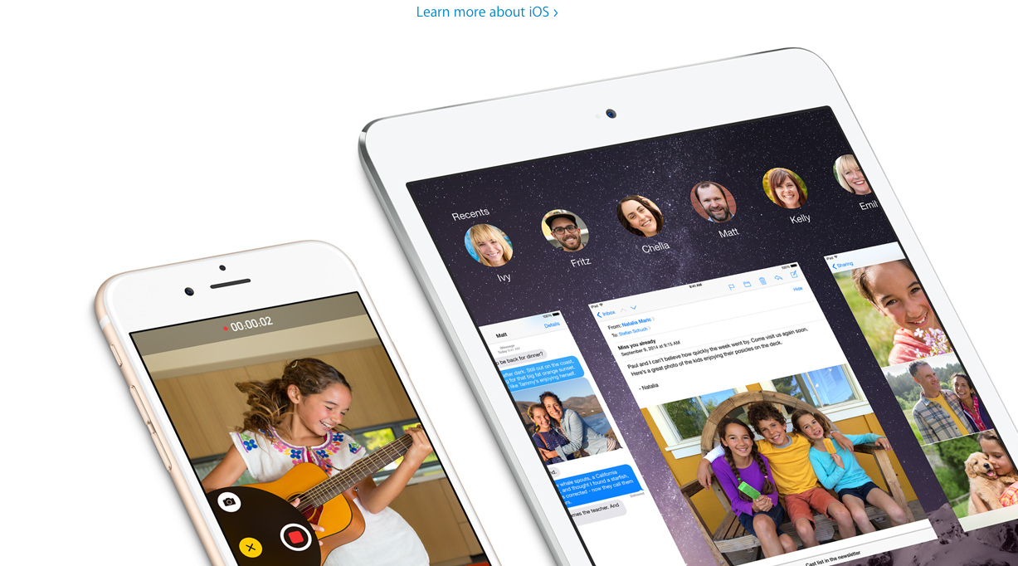
for iPhone/ iPad

Slide 5
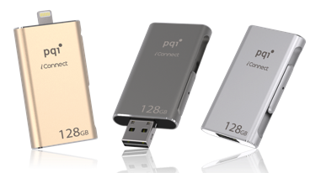
PQI Confidential & Property
Date: June 2015
Notes:
Today, I would like to share PQI iStorage product marketing and product plan with Steve.

Slide 6
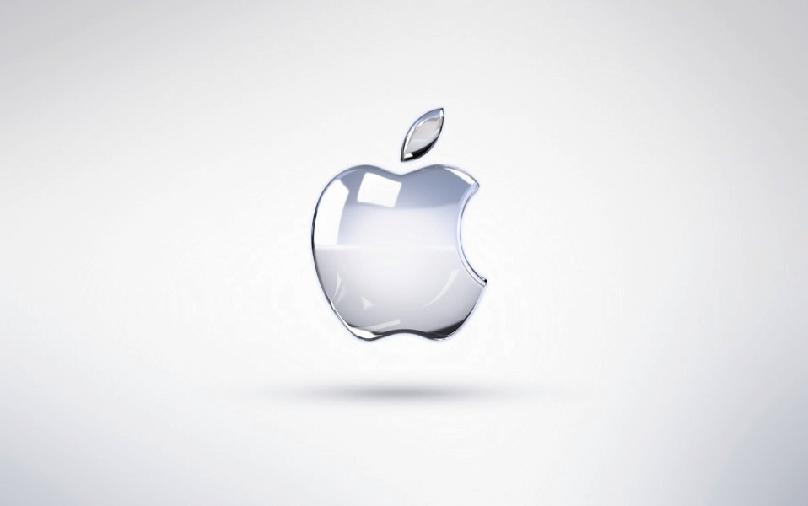
APPLE i-Device Trend Analysis

Slide 7
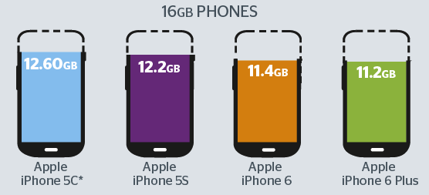
How much storage space does iPhone really have?
iOS 8.1.3 occupy iPhone 4.7GB
Notes:
iOS occupy Phone 4.7GB and that’s mean we just only really have around 11GB for APP download and all audio/Video we take.

Slide 8
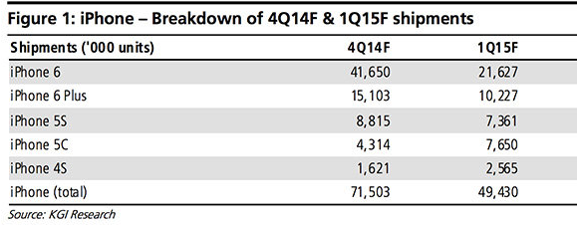
TAM (Total Available Market)
User Demand:
iPhone 4Q14-1Q15(F) shipment 120Mpcs, 16GB 45% ,50-60Mpcs.

Slide 9
iPhone sales by region
- Region sales:
USA 40.9%, EU 22.8%,Great China 21.6% (China/TW/HK), Japan 7.4%, Rest of Asia Pacific 7%
40.9%
22.8%
21.6%
7.4 %
7.0%
9
http://forums.appleinsider.com/t/184535/china-responsible-for-massive-apple-revenue-growth-reaches-16-1b-in-q1

Slide 10
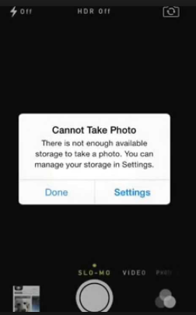
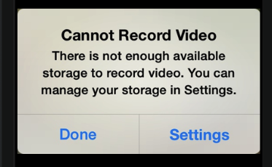
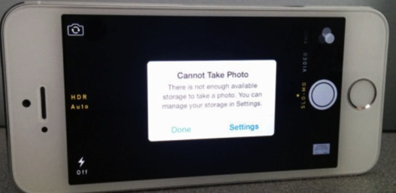
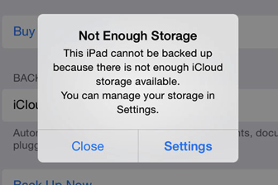
Cannot Record Video!!
But iPhone, iPad or iPod touch Ran Out of Storage Space ?
Notes:
There are so many user complains we hear from internet forum and Apple store, 16GB users don’t have enough space to store their photo and video.

Slide 11
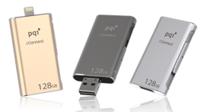
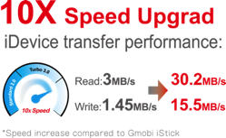
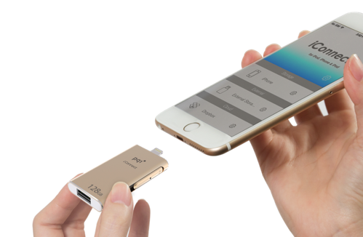
Get More Space for Your iPhone and iPad
The World Fastest
～iConnect extreme high-speed dual flash drive, advanced efficiency, the world’s No.1 transferring speed
Feature：
Free up space
Two-way high-speed data transfer
Lightning read/write speed: 30/15 MB/s;
USB 3.0 read/write speed: 95/25 MB/s
Watch movie and play music anywhere, anytime
File encryption ＆ File compression
Interface：Apple MFi Certified Lightning Interface & Standard USB3.0
Capacity：16GB / 32GB / 64GB / 128GB
OS Supported： Windows Vista, Windows 7, Windows 8,
Mac OS X v10.6+
Dimensions：54.2 x 31.3 x 8.3 mm
Weight：21g
Warranty：2 Years
Compatibility：iPhone 6 Plus, iPhone 6, iPhone 5s, iPhone 5c, iPhone 5, iPad Air 2,iPad Air, iPad (4th generation), iPad mini 3, iPad mini2, iPad mini, iPod touch (5th generation) and newer (iOS 7.1+)

Slide 12
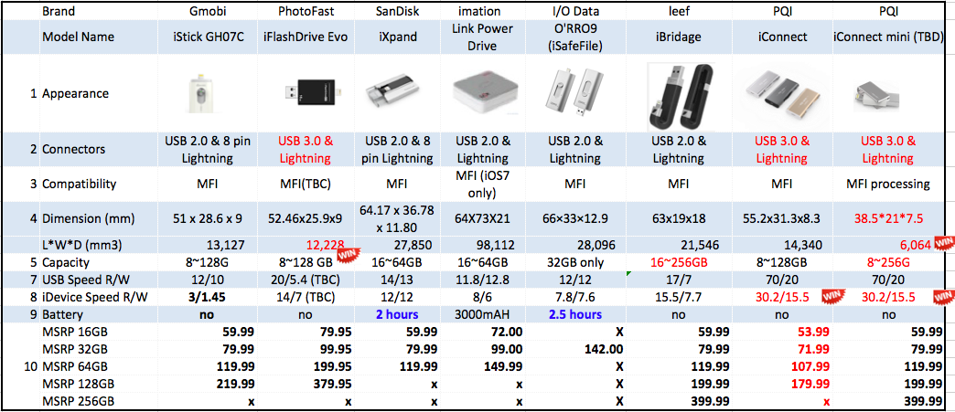
Right Product Specification

Slide 13
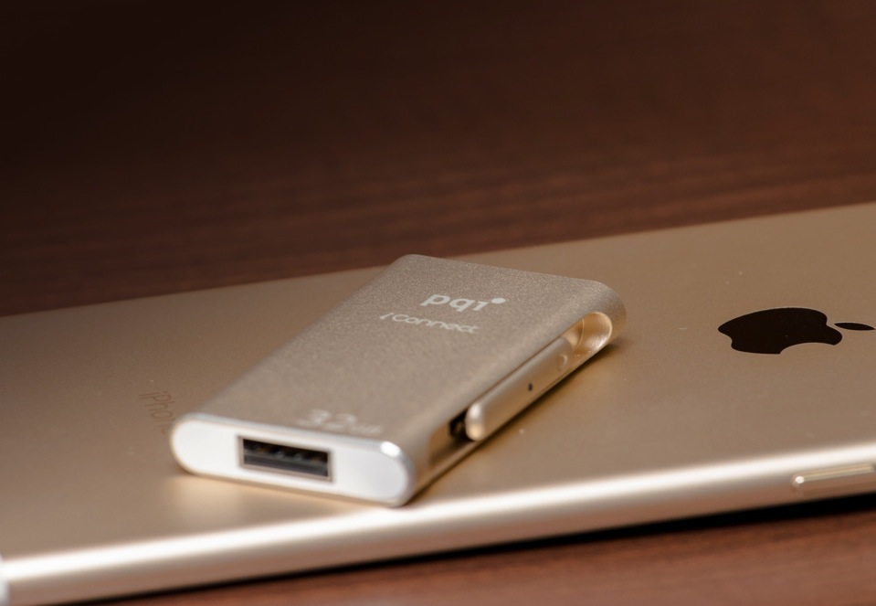
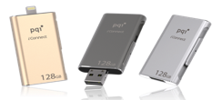
Made for iPhone, iPad & iPod

Slide 14
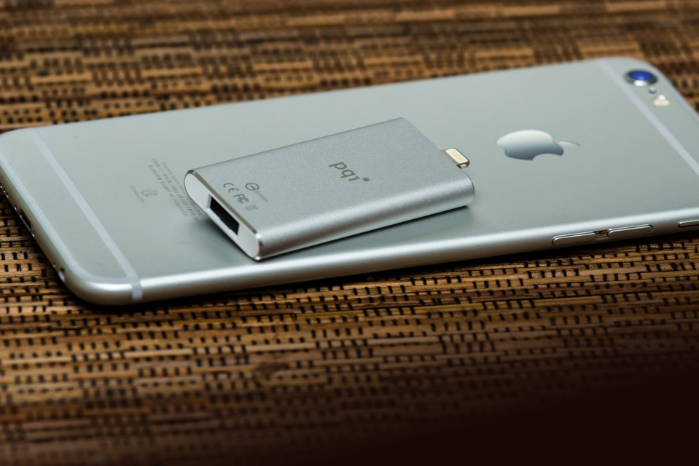
Made for iPhone, iPad & iPod

Slide 15
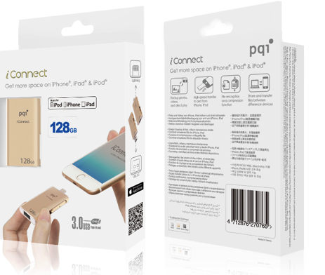
Product Info.
Package
Dimension: 173x109x25 mm
Weight: 71.9g
30pcs / carton

Slide 16
iStorage Roadmap
MP in Q3

Slide 17
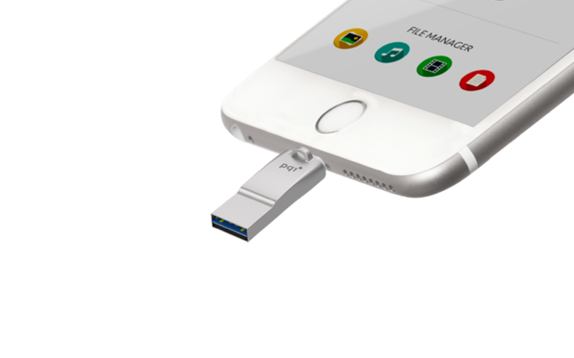
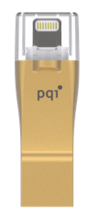
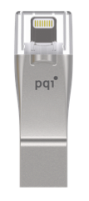
World smallest Lightning / USB 3.0 drive
The World Smallest
～iConnect mini dual flash drive,
exclusive PQI COB 3.0 patent, the world’s No.1 tiny size
Feature：
Lightning / USB 3.0 dual-interface - easily share files between iOS, Mac and PC
USB 3.0 COB patented technology
Ultra slim with metal material design
Photo capture directly store to iConnect mini
Watch movie and play music anywhere, anytime
File encryption & File compression
Interface：Apple MFi Certified Lightning Interface & Standard USB3.0
OS Supported： Windows Vista, Windows 7, Windows 8, Mac OS X v10.6+
Capacity：16GB / 32GB / 64GB / 128GB
Dimensions：45 x 15x 7.0 mm Warranty：2 Years
Compatibility：iPhone 6 Plus, iPhone 6, iPhone 5s, iPhone 5c, iPhone 5, iPad Air 2,iPad Air, iPad (4th generation), iPad mini 3, iPad mini2, iPad mini, iPod touch (5th generation) and newer (iOS 7.1+)
Notes:
絕對是全世界最小 第二代是第一代30%的大小

Slide 18
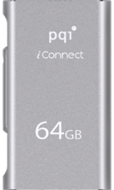
iConnect mini: iConnect= 33%:1
iConnect mini : 45x15x7 = 4,725 mm³
iConnect : 55.2 x 31.3 x 8.3 = 14,340 mm³
T: 8.30 mm
T: 7 mm
45 mm
55.2 mm
15 mm
31.3 mm
mini
iConnect

Slide 19
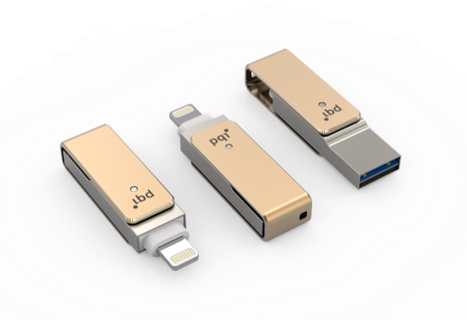
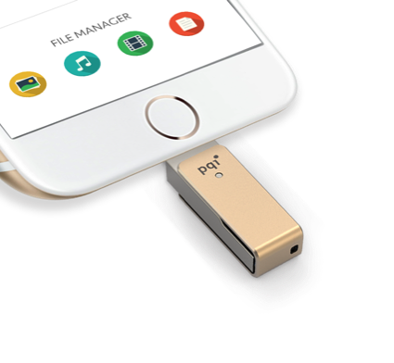
World smallest Lightning / USB 3.0 drive
The World Smallest
～iConnect mini dual flash drive,
exclusive PQI COB 3.0 patent, the world’s No.1 tiny size
Feature：
Lightning / USB 3.0 dual-interface - easily share files between iOS, Mac and PC
USB 3.0 COB patented technology
Rotate, cap-less design
Photo capture directly store to iConnect mini
Watch movie and play music anywhere, anytime
File encryption & File compression
Interface：Apple MFi Certified Lightning Interface & Standard USB3.0
OS Supported： Windows Vista, Windows 7, Windows 8, Mac OS X v10.6+
Capacity：16GB / 32GB / 64GB / 128GB
Dimensions：45 x 15x 7.0 mm Warranty：2 Years
Compatibility：iPhone 6 Plus, iPhone 6, iPhone 5s, iPhone 5c, iPhone 5, iPad Air 2,iPad Air, iPad (4th generation), iPad mini 3, iPad mini2, iPad mini, iPod touch (5th generation) and newer (iOS 7.1+)

Slide 20
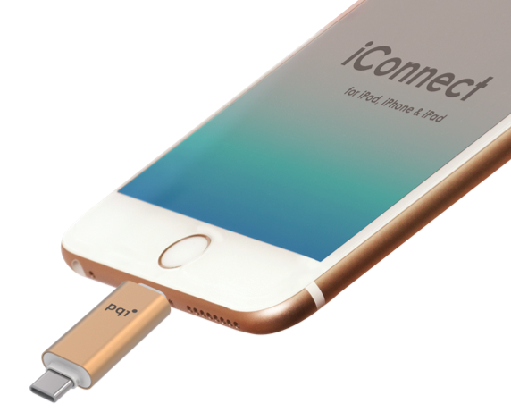
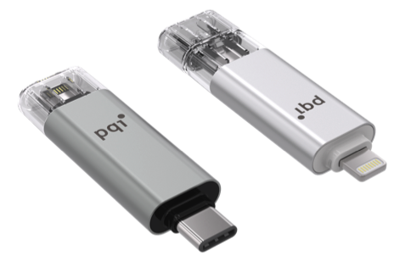
Lightning & Type-CTM drive
The World First
~ iConnect C (Lightning / Type-CTM)
dual-function flash drive, bidirectional
access, the world’s No.1 technology
Feature：
Lightning / Type-C TM dual-interface - easily share files between iOS, Mac and PC
Free up space
Ultra slim with metal material design
Photo capture directly store to iConnect C
Watch movie and play music anywhere, anytime
File encryption & File compression
Interface：Apple MFi Certified Lightning Interface & Type-CTM
OS Supported： Windows Vista, Windows 7, Windows 8, Mac OS X v10.6+
Capacity：16GB / 32GB / 64GB / 128GB
Dimensions：54 x 16x 7.5 mm Warranty：2 Years
Compatibility：iPhone 6 Plus, iPhone 6, iPhone 5s, iPhone 5c, iPhone 5, iPad Air 2,iPad Air, iPad (4th generation), iPad mini 3, iPad mini2, iPad mini, iPod touch (5th generation) and newer (iOS 7.1+)
Notes:
現當今我們最快展出

Slide 21
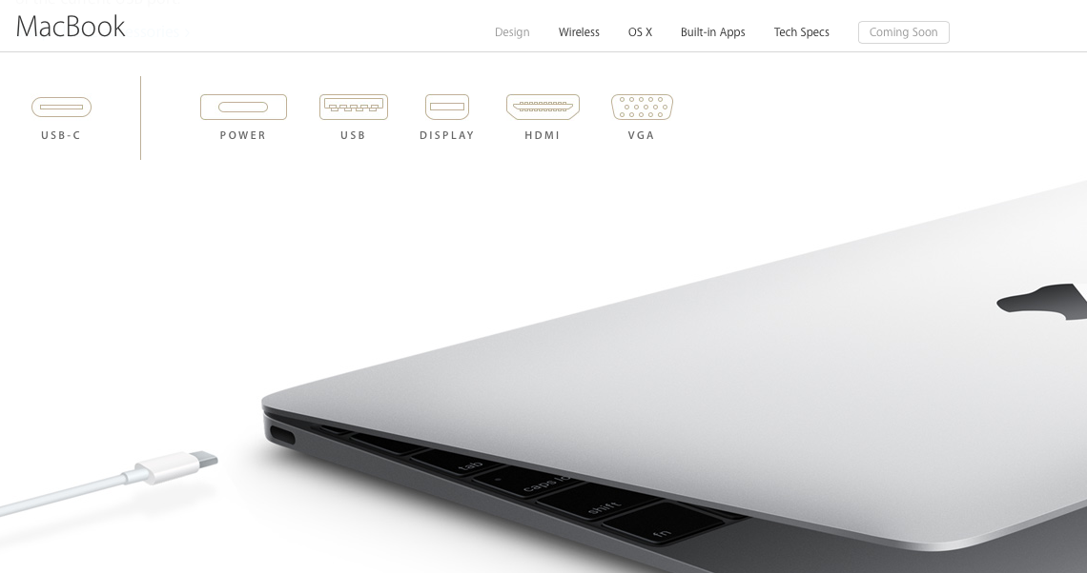
Incredibly portable. With one amazing port- USB Type C
Notes:
Macbook pioneer
typeC 取代 各種聲音影像電源

Slide 22
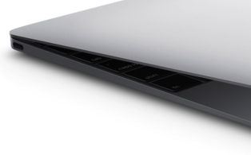
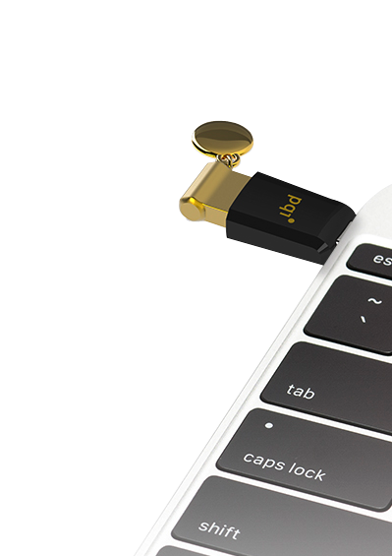
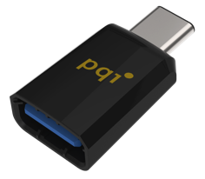
Connect 311
~ World’s newest USB3.1 Type-C™ Adaptor
Feature：
For USB Type C –
An entirely new design tailored to work well with emerging product design.
New smaller size- similar in size to the existing USB 2.0 Micro-B.
Usability enhancements- users will no longer need to be concerned with plug orientation /cable direction , making it easier to plug in.
The Type-C connector and cable will support scalable power charging.
For USB 3.1 –
The USB3.1 introducing a faster transfer mode called
“SuperSpeed USB 10 Gbps”;its logo features a SuperSpeed+(stylized as SuperSpeed+) caption.
The USB 3.1 standard increases the signaling rate to 10 Gbit/s, double that of USB 3.0.
Add Type C interface , sockets and wires are not compatible with the original Type A and and Type B.
Interface：USB 3.1 Type-C™; USB 3.1 Type-A female
Capacity：16G Depends on UFD capacity
Dimensions：31 x 16 x 8.8 mm
Weight ：2.64 g
Warranty：2 Years
Notes:
TypeC 必定是將來不只是mobile, notebook所有會用的街頭

Slide 23
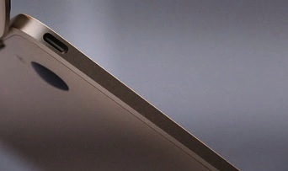
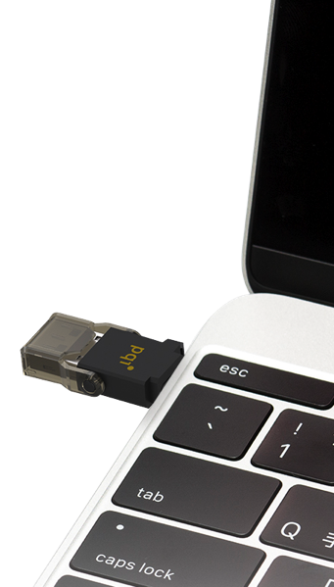
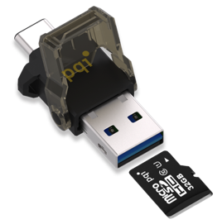
Connect 312
~ USB 3.1 Type-C™ OTG reader
Feature：
Support micro SD card
True plug & play, and hot swapping
View, edit and copy photos/data/music
USB 3.0 Superspeed data/files access and transferrate up to 5Gbps
No driver is needed for Windows XP , Vista ,WIN 7,WIN 8,WIN 8.1,Mac OS 10.4+, Android 4.0+, Linux 2.4+,Chromium OS.
Compatible with PC & Mac & Chrome & Android
Support microSD, microSDHC, microSD USH1
Interface：USB 3.1 Type-C™; USB 3.1 G1 Type A; micro SD
Capacity：Base on TF Card (4~128GB)
Dimensions：42.4 x 20.4x 8.4 mm
Weight：4.9 g
Warranty：2 Years
NOTE: The microSD card does not support hot-swap capability

Slide 24
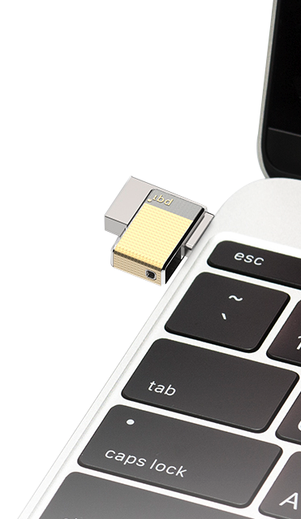
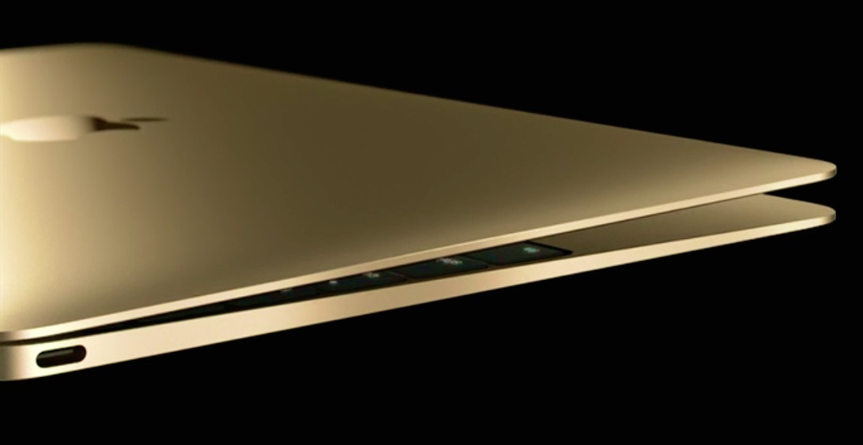
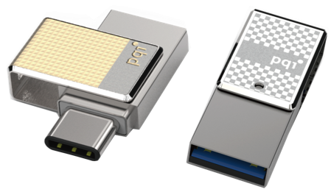
Connect 313
~ USB 3.1 Type-C™ OTG flash drive
Feature：
Expand new MacBook & Mobile memory
USB 3.0 COB patented technology
Rotate, cap-less design
Faster and reliable
Interface：USB 3.1 G1 Type-A & USB 3.1 Type-C™
Capacity：16/32/64/128GB
Dimensions：30.8 x 12.2 x 6.6 (mm)
Weight：4.8g
Warranty：2 Years
Compatible with the newest generation of MacBook

Slide 25
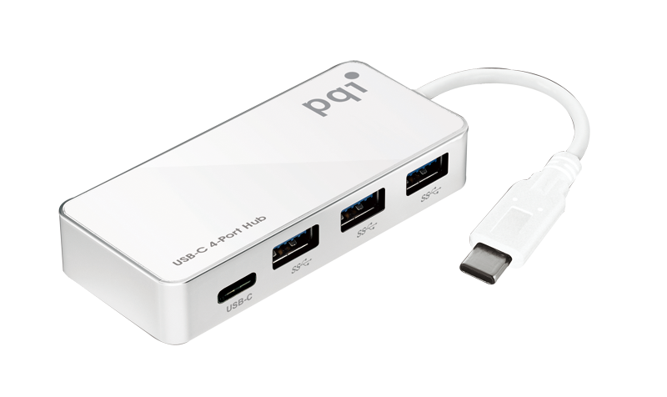
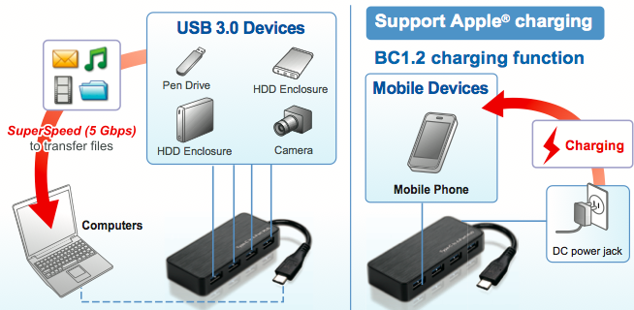
Connect 314
~ USB-C™ 4 Port Hub
Feature：
USB 3.0 Output Port x4
Type-C Input Port x1
Support auto switching between self-powered
Interface:
USB 3.0 Output Port x4
- Hub downstream link, USB 3.0 type C female x1, charging power up to 15W
- Hub downstream link, USB 3.0 type A female x3
USB 3.0 Input Port x1
- Host upstream link, USB 3.0 type C male
DC Power Jack x 1
Power Supply:
Self-Power
Switching power adapter
- Input: AC 100-240V / Output: DC 5V 4
Dimensions:91 x 40.5 x 16 (mm)
Weight:50g
Warranty:2 Years
OS Supported:Wndows® 7, Windows® 8, Windows® 8.1, Mac OS®

Slide 26
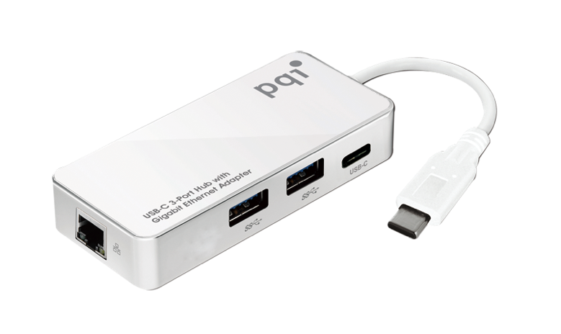
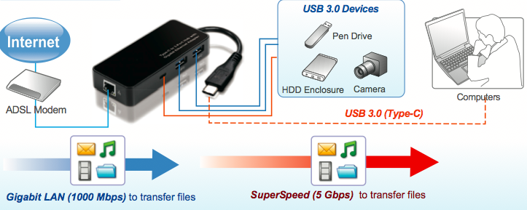
Connect 315
~ Type-CTM to 3-Port Hub with Gigabit Ethernet
Feature：
USB 3.0 Output Port x3
Type-CTM Input Port x1
Gigabit Ethernet Output Port
Support wake-on-LAN function
Support Green Ethernet
Support IEEE 802.3az(Energy Efficient Ethernet)
Support IPV4/IPV6 pack Checksum Offload Engine(COE) to reduce
Interface：
USB 3.0 Output Port x3
- Hub downstream link, USB 3.0 type C female x1, charging power up to 15W
- Hub downstream link, USB 3.0 type A female x2
USB 3.0 Input Port x1
- Host upstream link, USB 3.0 type C male
RJ-45 x 1 (Ethernet 10/100/1000M Gigabit):
- Complies with the Full-duplex with flow control
and Half-duplex with
backpressure operation
Power Supply：Bus-Powered
Dimensions：91 x 40.5 x 16 (mm)
Weight：50g
Warranty：2 Years
OS Supported：Windows® 7, Windows® 8, Windows® 8.1, Mac OS®

Slide 27
2015 Metallic Power Bank

Slide 28
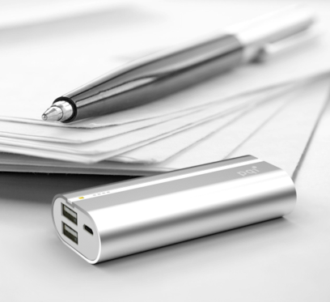
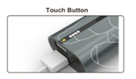
PQI Power 6000V
Perfect Dimension of Metallic Power Bank
One for All
Smart Capacity
Safe
support dual USB ports charging table and smart phone simultaneously
Perfect dimension of Metallic Power bank
Perfect weight.
Support charging i-Phone 6 2.4 Times/6+ 1.5 Times
Overcharging protection
Over-discharging protection
Short-circuiting protection
Current overflow protection
Electrical leakage protection
US$10 Million Products Liability Insurance
91 mm
USB 2.4A
Output
41.7 mm
Micro USB
2A input
Capacity:6000mAh Interface: USB x 2, Micro USB x 1
Input: 5V 2A Output: Total output 5V 3.9A
(5V1.5A/5V2.4A)
Charging cable included
USB 1.5A
Output

Slide 29
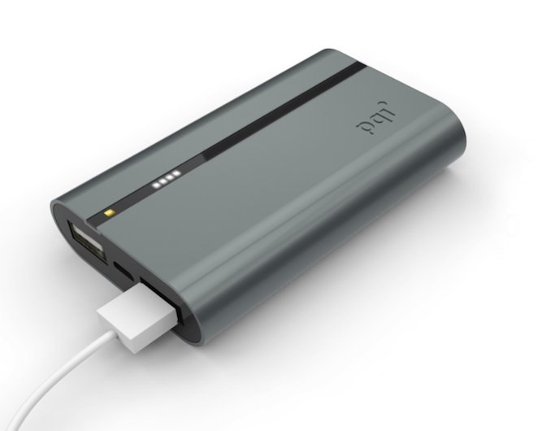
PQI Power 9000V
Perfect Dimension of Metallic Power Bank
One for All
Big Capacity
Safe
support dual USB ports charging table and smart phone simultaneously
Support charging i-Phone 6 3.6 Times/6+ 2.2Times
Overcharging protection
Over-discharging protection
Short-circuiting protection
Current overflow protection
Electrical leakage protection
US$10 Million Products Liability Insurance
58.7mm
95.7 mm
USB 2.4A
Output
USB 2A
input
USB 1.5A
Output
Capacity:9000mAh Interface: USB x 2, Micro USB x 1
Input: 5V 2A Output: Total output 5V 3.9A
(5V1.5A/5V2.4A)
Charging cable included

Slide 30
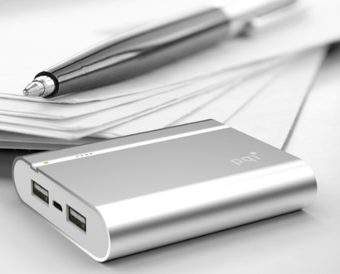
PQI Power 12000V
Huge capacity Metallic Power Bank
One for All
Huge Capacity
Safe
support dual USB ports charging table and smart phone simultaneously
Perfect dimension of Metallic Power bank
Perfect weight.
Support charging i-Phone 6 4.8 Times/6+ 2.9 Times
Overcharging protection
Over-discharging protection
Short-circuiting protection
Current overflow protection
Electrical leakage protection
US$10 Million Products Liability Insurance
96.7 mm
77.4mm
USB 2.4A
Output
USB 2A
input
Capacity:12000mAh Interface: USB x 2, Micro USB x 1
Input: 5V 2A Output: Total output 5V 3.9A
(5V1.5A/5V2.4A)
Charging cable included
USB 1.5A
Output

Slide 31
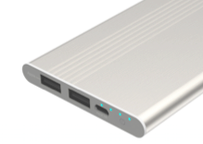
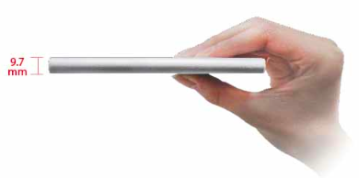
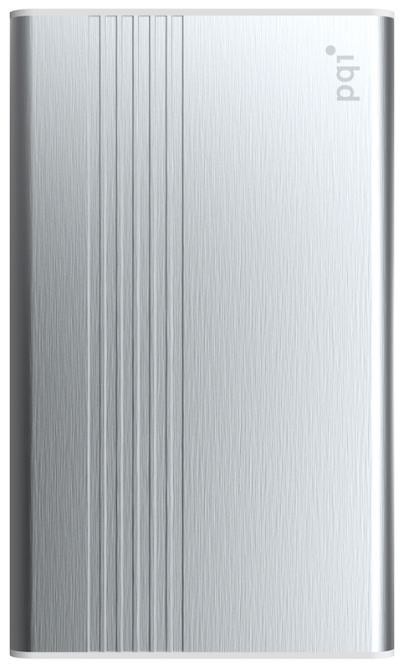
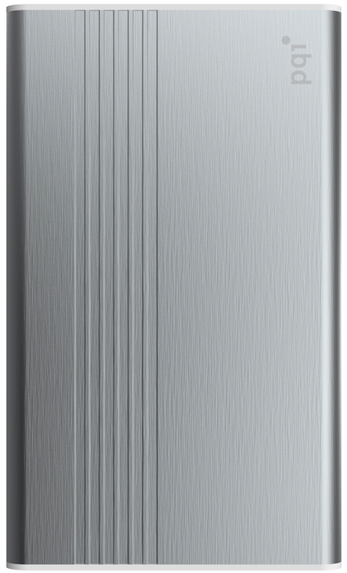
PQI Power 5000V
Ultra-slim power bank
for charging smartphones and tablets
One for All
Smart Capacity
Safe
support dual USB ports charging
Fast charging of Power bank
Ultra Slim Li-polymer Metallic Power bank
Support charging i-Phone 6 1.8 Times/6+ 1 Times
Overcharging protection
Over-discharging protection
Short-circuiting protection
Current overflow protection
Electrical leakage protection
US$10 Million Products Liability Insurance
USB 2.4A
Output
USB 1.5A
Output
USB2A
input
90.8 mm
72.2mm
Capacity:5000mAh Interface: USB x 2, Micro USB x 1
Input: 5V 2A Output: Total output 5V 2.4A max
(5V1A/5V2.4A)
Charging cable included

Slide 32
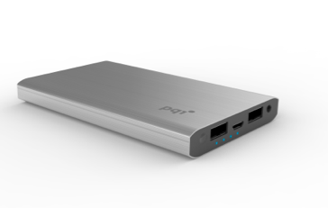
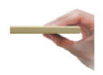
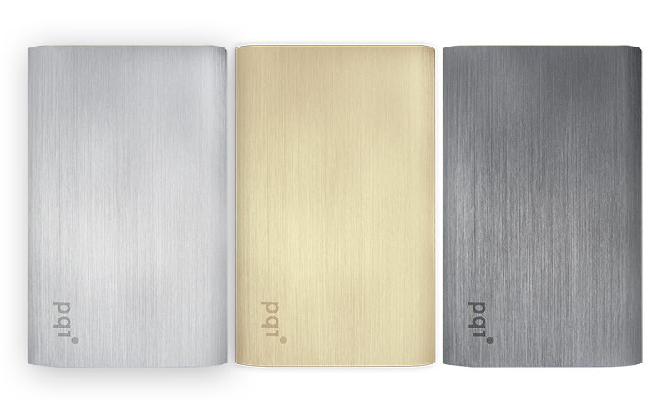
PQI Power 10000V
Ultra-slim huge capacity power bank
for charging smartphones and tablets
One for All
Huge Capacity
Safe
support dual USB ports charging
Fast charging of Power bank
Ultra Slim Li-polymer Metallic Power bank
Support charging i-Phone 6 3.5 Times/6+ 2.2 Time
Overcharging protection
Over-discharging protection
Short-circuiting protection
Current overflow protection
Electrical leakage protection
US$10 Million Products Liability Insurance
LED flashlight
USB2A
input
USB 1.5A
Output
USB 2.1A
Output
90.8 mm
13.5mm
72.2mm
Capacity:10000mAh Interface: USB x 2, Micro USB x 1
Input: 5V 2A Output: Total output 5V 3.6A max
(5V1.5A/5V2.1A)
Charging cable included

Slide 33
i-Power 5000C
Elegant
Fast
Safe
Colorful power bank
Unique design
Output 5V 2.1A Fast Charging mobility device
Overcharging protection
Over-discharging protection
Short-circuiting protection
Current overflow protection
Electrical leakage protection
US$10 Million Products Liability Insurance
Colorful power bank
for charging smartphones and tablets
LED flashlight
USB Output
Micro USB Input
Power Indicator
Power Indicator
Button
Capacity: 5000mAh Interface: USB x 1, Micro USB x 1
Input: 5V 1A Output: 5V 2.1A
Charging cable included
Li-polymer
battery inside

Slide 34
PQI Lightning cable

Slide 35
Cable
High-end
Apple MFI Certified
Retractable cable
i-cable Metallic
Multi-Plug
Value
Du-Plug
Flat 20 Cable Ring
Mesh Cable
Car charger
with du-plug cable
Basic
Lightning Cable 100cm/180cm
Lightning to Micro USB Adapter

Slide 36
PQI i-Cable Metallic
100cm
Metallic-designed cable specially for iPhone 6/ 6 Plus And with Reversible Standard USB connector

Slide 37
Metallic Lightning cable
Apple Certified
Durable
Classic color
MFI Certification
Support iPhone 6/6+/5/5S/5C, iPad 4, i-Pad Air, iPad Mini, and iPod 5+
Enhanced design
High quality manufacturing
Gray & Silver & Gold
Outstanding packaging
Flat cable resists tangling kinking
Reversible Standard USB
connector
- Allows to plug in any direction
Apple Style Color design

Slide 38
PQI i-Cable Standard
100cm
180cm
100 cm
180 cm

Slide 39
i-Cable 100/180
Apple Certified
Durable
Classic color
MFI Certification
Support iPhone 6/6+/5/5S/5C, iPad 4, i-Pad Air, iPad Mini, and iPod 5+
Enhanced design
High quality manufacturing
180 cm Black & White
100 cm Black & White & Blue &Pink
Apple Certified Lightning Cable
New narrow lightning connector – can still plug in iPhone with casing
Length: 100cm(Black / White/Blue/Pink)
/180cm (Black / White)
Interface: Apple Lightning x 1, USB x 1

Slide 40
i-Cable Du-Plug 90CM
Apple & Android
Durable
Classic & Colorful
MFI Certification
Support iPhone 6/6+/5/5S/5C, iPad 4, i-Pad Air, iPad Mini, and iPod 5+
Support Android phone and tablet
Enhanced design
High quality manufacturing
Black & White
Apple Certified Lightning Cable
+ Micro USB Cable for Android / DSC
Length: 15CM/90CM
Interface: Apple Lightning x 1, Micro USB x 1, USB x 1

Slide 41
i-Cable Multi-Plug
Apple & Android
Durable
Classic & Colorful
MFI Certification
Support iPhone 6/6+/5/5S/5C, iPad 4, i-Pad Air, iPad Mini, and iPod 5+
Support new and older Apple devices
Support Android phone and tablet
Enhanced design
High quality manufacturing
Black & White
Apple Certified Lightning Cable
+ Apple Certified 30-pin Cable
+ Micro USB Cable for Android
Length: 90CM
Interface: Apple Lightning x 1, Apple 30-pin x 1, Micro USB x 1, USB x 1

Slide 42
for Mac

