Slide 1
│Q2 │ Company Profile │
2
0
1
5

Slide 2
About PQI
Founded 1997
Chairman: Mr. T.C. Gou
IPO at TSEC in 2003
Joined Foxlink Group in 2010
2013 Sales Revenue: US$ 370M
Market Capital: US$ 10 M
Number of Employees: 120+ worldwide

Slide 3
Foxlink Group
Chairman: T.C. Guo
Brother company of Foxconn
Apple’s OEM manufacture

Slide 4
Why PQI
Milestones
Wide and competitive product lines
Notes:
4

Slide 5
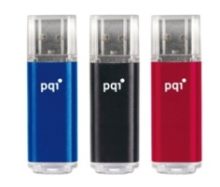
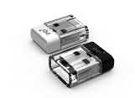
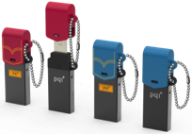
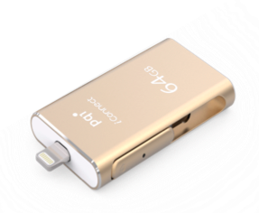
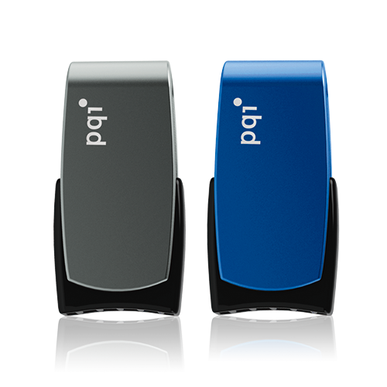
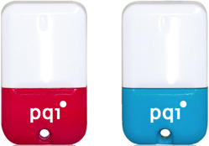
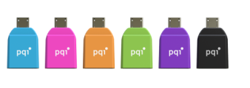
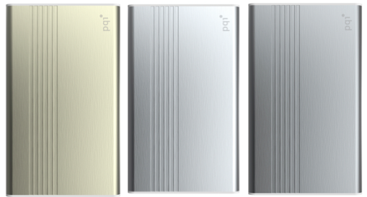
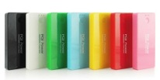
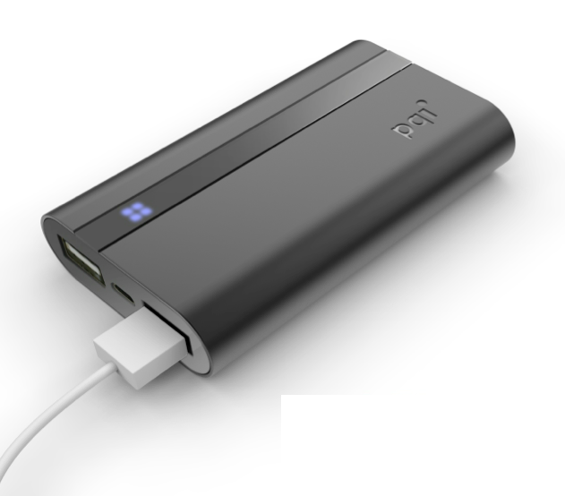
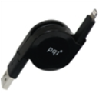
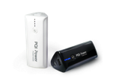
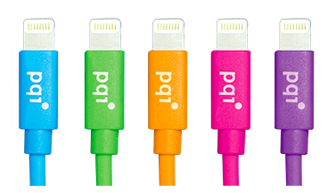
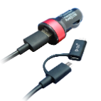
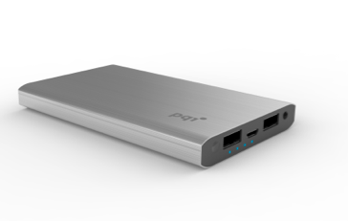
Flash Card & Drive
Air & OTG
Awards
Product lines
Mobile Power Bank
Mobile Cable & Charger

Slide 6
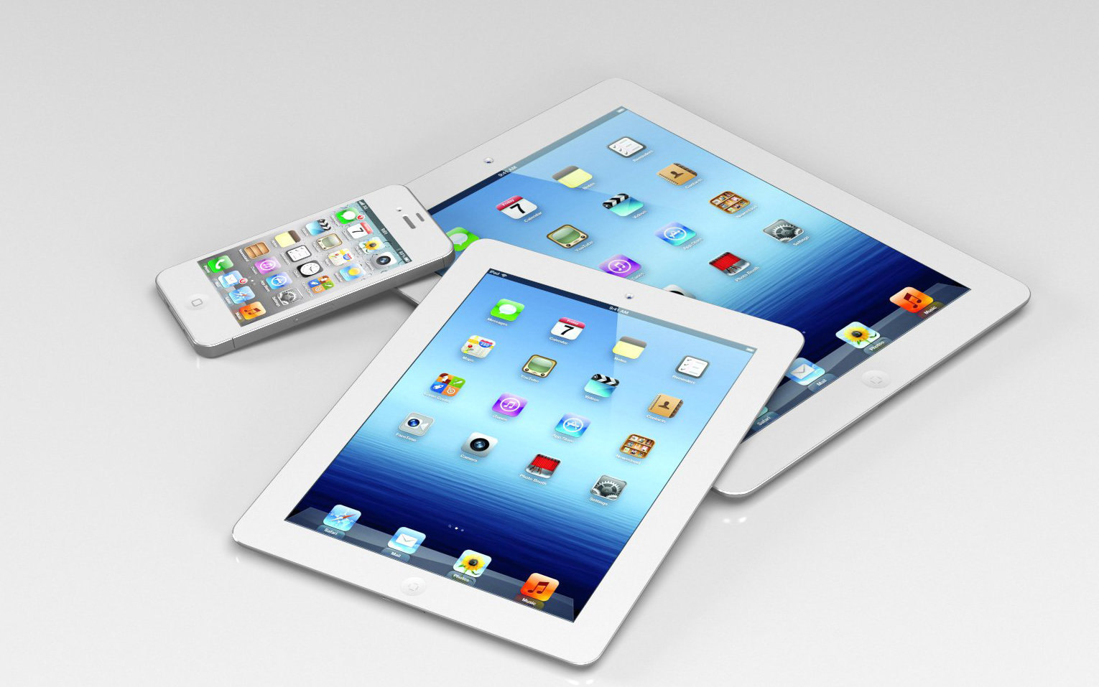
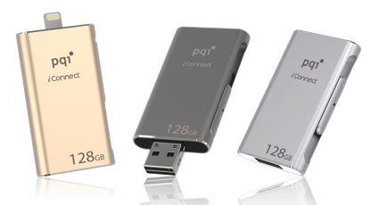
Apple iStorage
Bigger than Bigger
Notes:
去年九月到今年三月16GB賣七千五百萬隻~~~~~~

Slide 7
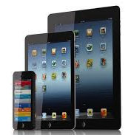
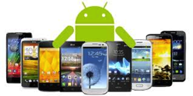
Storage Product Application
USB3.1 C OTG
-Adapter
-Type C Reader
- OTG UFD
USB3.1 C Storage
--USB3.1 HUB
-USB3.1 UFD
iStorage
-iConnect
-iConnect mini
-
Notes:
分成三個區塊

Slide 8
iStorage Comparison
Notes:
Stand by 30 (?) mini安培
蘋果很在意iStorage會不會影響到它本身的performance

Slide 9
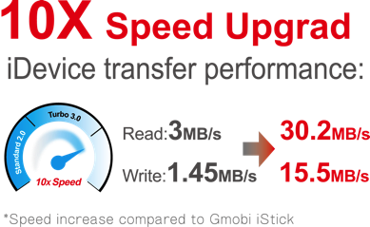
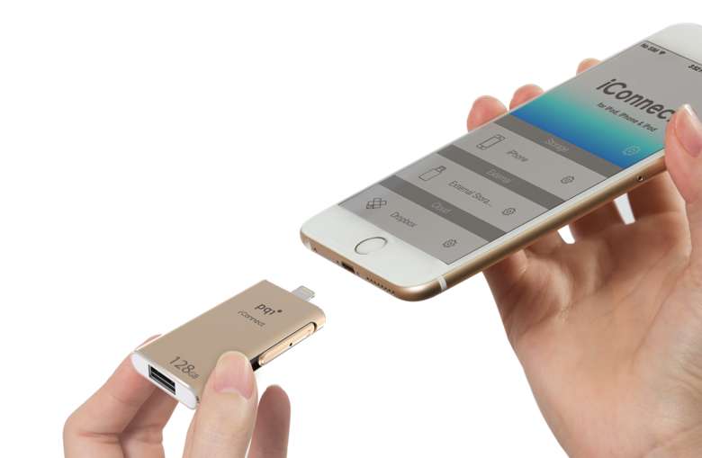
Get More Space for Your iPhone and iPad
The World Fastest
～iConnect extreme high-speed dual flash drive, advanced efficiency, the world’s No.1 transferring speed
Feature：
Free up space
Two-way high-speed data transfer
Lightning read/write speed: 30/15 MB/s;
USB 3.0 read/write speed: 95/25 MB/s
Watch movie and play music anywhere, anytime
File encryption ＆ File compression
Interface：Apple MFi Certified Lightning Interface & Standard USB3.0
Capacity：16GB / 32GB / 64GB / 128GB
OS Supported： Windows Vista, Windows 7, Windows 8,
Mac OS X v10.6+
Dimensions：54.2 x 31.3 x 8.3 mm
Weight：21g
Warranty：2 Years
Compatibility：iPhone 6 Plus, iPhone 6, iPhone 5s, iPhone 5c, iPhone 5, iPad Air 2,iPad Air, iPad (4th generation), iPad mini 3, iPad mini2, iPad mini, iPod touch (5th generation) and newer (iOS 7.1+)
Notes:
需要手機的容量會越來越多**

Slide 10
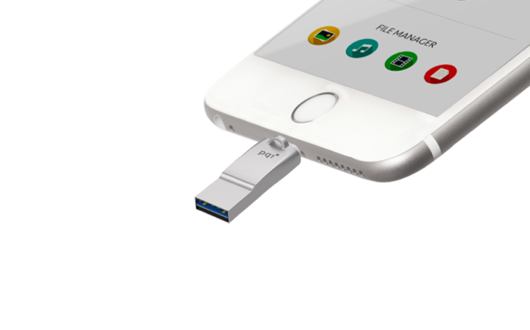
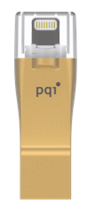
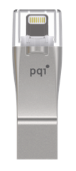
World smallest Lightning / USB 3.0 drive
The World Smallest
～iConnect mini dual flash drive,
exclusive PQI COB 3.0 patent, the world’s No.1 tiny size
Feature：
Lightning / USB 3.0 dual-interface - easily share files between iOS, Mac and PC
USB 3.0 COB patented technology
Ultra slim with metal material design
Photo capture directly store to iConnect mini
Watch movie and play music anywhere, anytime
File encryption & File compression
Interface：Apple MFi Certified Lightning Interface & Standard USB3.0
OS Supported： Windows Vista, Windows 7, Windows 8, Mac OS X v10.6+
Capacity：16GB / 32GB / 64GB / 128GB
Dimensions：45 x 15x 7.0 mm Warranty：2 Years
Compatibility：iPhone 6 Plus, iPhone 6, iPhone 5s, iPhone 5c, iPhone 5, iPad Air 2,iPad Air, iPad (4th generation), iPad mini 3, iPad mini2, iPad mini, iPod touch (5th generation) and newer (iOS 7.1+)
Notes:
絕對是全世界最小 第二代是第一代30%的大小

Slide 11
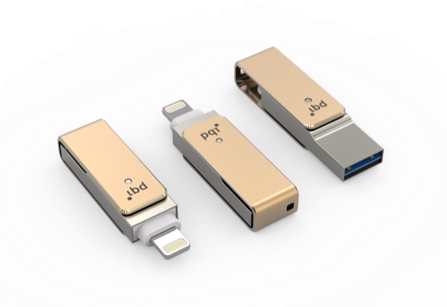
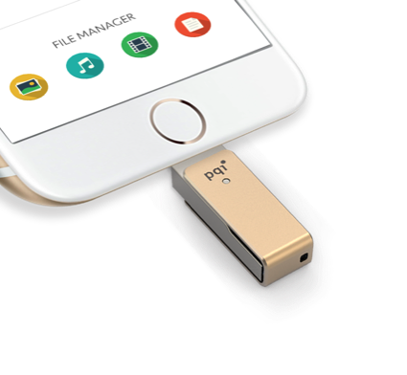
World smallest Lightning / USB 3.0 drive
The World Smallest
～iConnect mini dual flash drive,
exclusive PQI COB 3.0 patent, the world’s No.1 tiny size
Feature：
Lightning / USB 3.0 dual-interface - easily share files between iOS, Mac and PC
USB 3.0 COB patented technology
Rotate, cap-less design
Photo capture directly store to iConnect mini
Watch movie and play music anywhere, anytime
File encryption & File compression
Interface：Apple MFi Certified Lightning Interface & Standard USB3.0
OS Supported： Windows Vista, Windows 7, Windows 8, Mac OS X v10.6+
Capacity：16GB / 32GB / 64GB / 128GB
Dimensions：45 x 15x 7.0 mm Warranty：2 Years
Compatibility：iPhone 6 Plus, iPhone 6, iPhone 5s, iPhone 5c, iPhone 5, iPad Air 2,iPad Air, iPad (4th generation), iPad mini 3, iPad mini2, iPad mini, iPod touch (5th generation) and newer (iOS 7.1+)

Slide 12
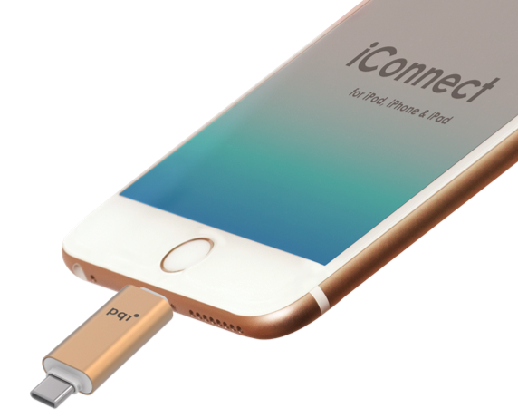
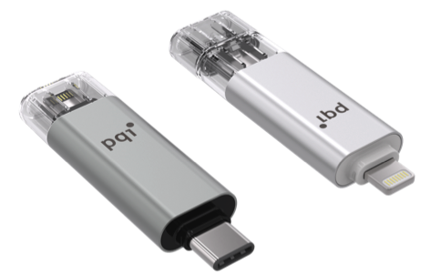
Lightning & Type-CTM drive
The World First
~ iConnect C (Lightning / Type-CTM)
dual-function flash drive, bidirectional
access, the world’s No.1 technology
Feature：
Lightning / Type-C TM dual-interface - easily share files between iOS, Mac and PC
Free up space
Ultra slim with metal material design
Photo capture directly store to iConnect C
Watch movie and play music anywhere, anytime
File encryption & File compression
Interface：Apple MFi Certified Lightning Interface & Type-CTM
OS Supported： Windows Vista, Windows 7, Windows 8, Mac OS X v10.6+
Capacity：16GB / 32GB / 64GB / 128GB
Dimensions：54 x 16x 7.5 mm Warranty：2 Years
Compatibility：iPhone 6 Plus, iPhone 6, iPhone 5s, iPhone 5c, iPhone 5, iPad Air 2,iPad Air, iPad (4th generation), iPad mini 3, iPad mini2, iPad mini, iPod touch (5th generation) and newer (iOS 7.1+)
Notes:
現當今我們最快展出

Slide 13
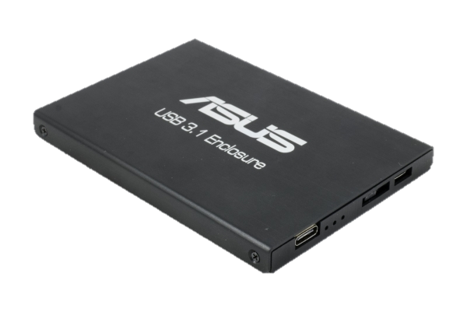
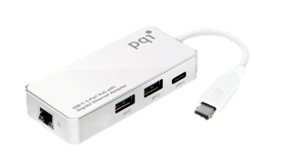
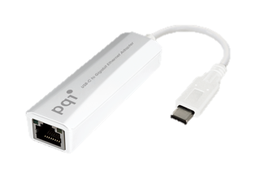
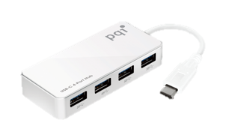
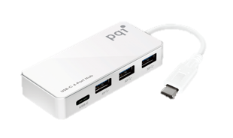
Connect Series
USB3.1 Type C
Apple mini 3
Nokia N1
Apple Macbook
PQI has bundle project with ASUS MB with Type C
ASUS USB 3.1 Enclosure
USB-C 3-Port Hub with Gigabit Ethernet Adapter
USB-C to Gigabit Ethernet Adapter
USB-C 4-Port Hub
USB-C 4-Port Hub
Notes:
為什麼ASUS會挑選PQI
在產品還沒出來之前 我們已經在ASUS作相容性測試

Slide 14
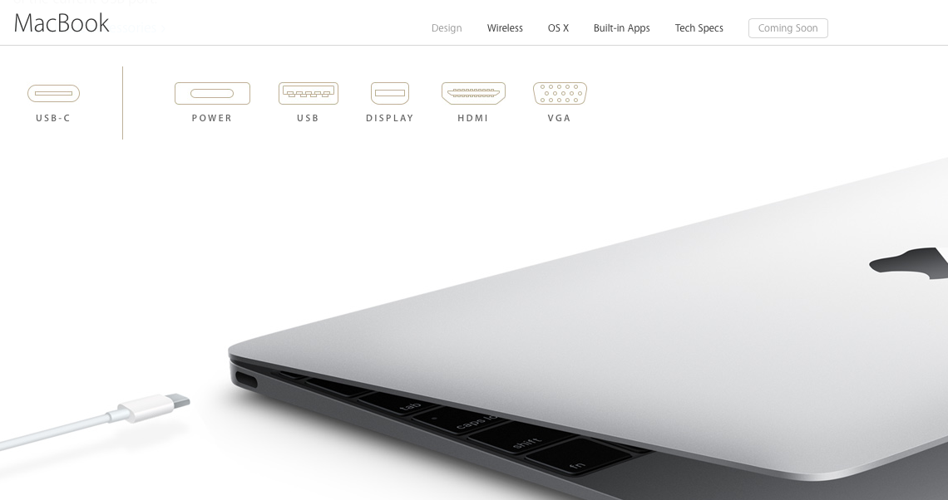
Incredibly portable. With one amazing port- USB Type C
Notes:
Macbook pioneer
typeC 取代 各種聲音影像電源

Slide 15
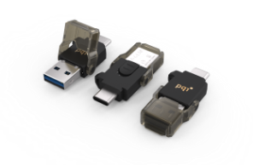
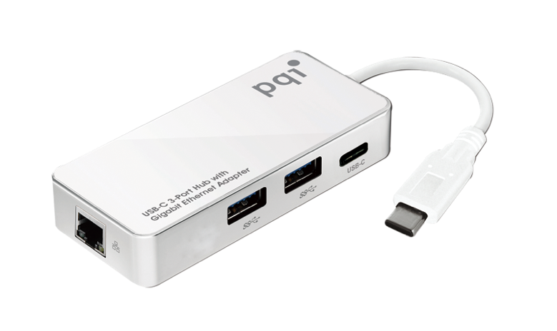
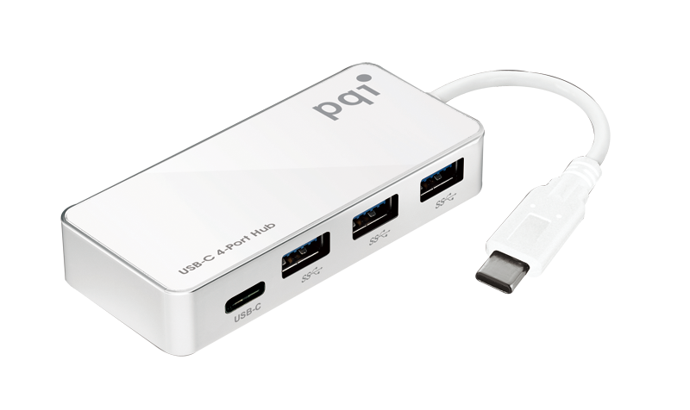
Connect Series Roadmap
USB3.1 Type C
_{USB3.0}
Connect 301
Connect 302
Connect 303/304
Connect
311
Connect 312
Connect 313
Connect 314
Connect 315
USB2.0, 4~32G
USB3.1 C, OTG Reader
16GB~64GB
USB3.1 C, OTG Flash Drive
16GB~64GB
USB3.0, 8GB-64GB
USB3.0,
8GB-64GB
USB2.0, 8GB
USB3.0,
8GB-64GB
USB3.1 C,
0GB
USB3.1 C, 4Port HUB
USB3.1 C, 4Port HUB+ Earthernet
Mass Production
2015 Q2
_{USB2.0}
Connect 201
Connect 203/204
Connect 210/211
USB2.0, 8GB-32GB
TF/SD/UFD/MHL
0GB
USB2.0, 8GB
USB2.0, 0GB
USB2.0, 8GB
Notes:
₁₅

Slide 16
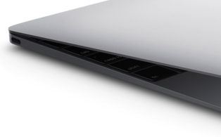
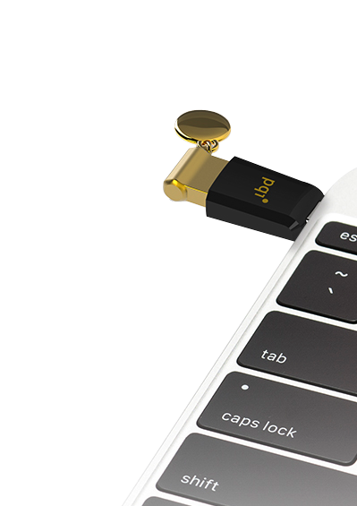
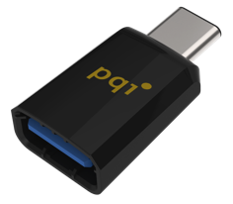
Connect 311
~ World’s newest USB3.1 Type-C™ Adaptor
Feature：
For USB Type C –
An entirely new design tailored to work well with emerging product design.
New smaller size- similar in size to the existing USB 2.0 Micro-B.
Usability enhancements- users will no longer need to be concerned with plug orientation /cable direction , making it easier to plug in.
The Type-C connector and cable will support scalable power charging.
For USB 3.1 –
The USB3.1 introducing a faster transfer mode called
“SuperSpeed USB 10 Gbps”;its logo features a SuperSpeed+(stylized as SuperSpeed+) caption.
The USB 3.1 standard increases the signaling rate to 10 Gbit/s, double that of USB 3.0.
Add Type C interface , sockets and wires are not compatible with the original Type A and and Type B.
Interface：USB 3.1 Type-C™; USB 3.1 Type-A female
Capacity：16G Depends on UFD capacity
Dimensions：31 x 16 x 8.8 mm
Weight ：2.64 g
Warranty：2 Years
Notes:
TypeC 必定是將來不只是mobile, notebook所有會用的街頭

Slide 17
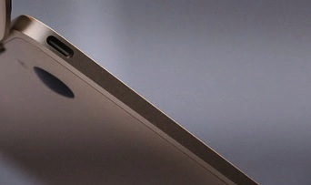
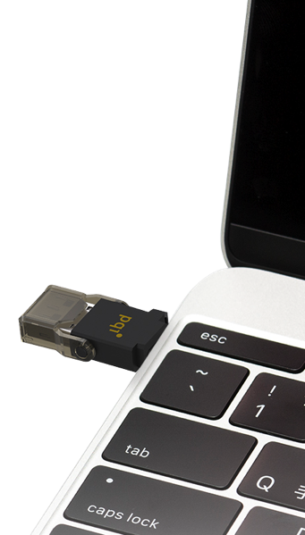
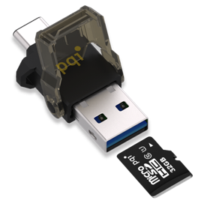
Connect 312
~ USB 3.1 Type-C™ OTG reader
Feature：
Support micro SD card
True plug & play, and hot swapping
View, edit and copy photos/data/music
USB 3.0 Superspeed data/files access and transferrate up to 5Gbps
No driver is needed for Windows XP , Vista ,WIN 7,WIN 8,WIN 8.1,Mac OS 10.4+, Android 4.0+, Linux 2.4+,Chromium OS.
Compatible with PC & Mac & Chrome & Android
Support microSD, microSDHC, microSD USH1
Interface：USB 3.1 Type-C™; USB 3.1 G1 Type A; micro SD
Capacity：Base on TF Card (4~128GB)
Dimensions：42.4 x 20.4x 8.4 mm
Weight：4.9 g
Warranty：2 Years
NOTE: The microSD card does not support hot-swap capability

Slide 18
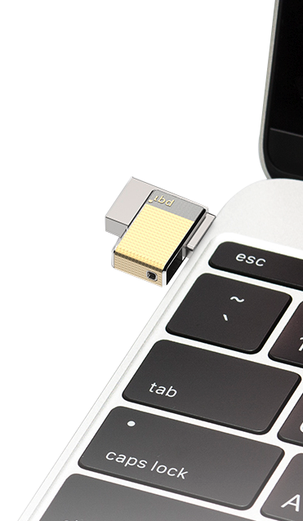
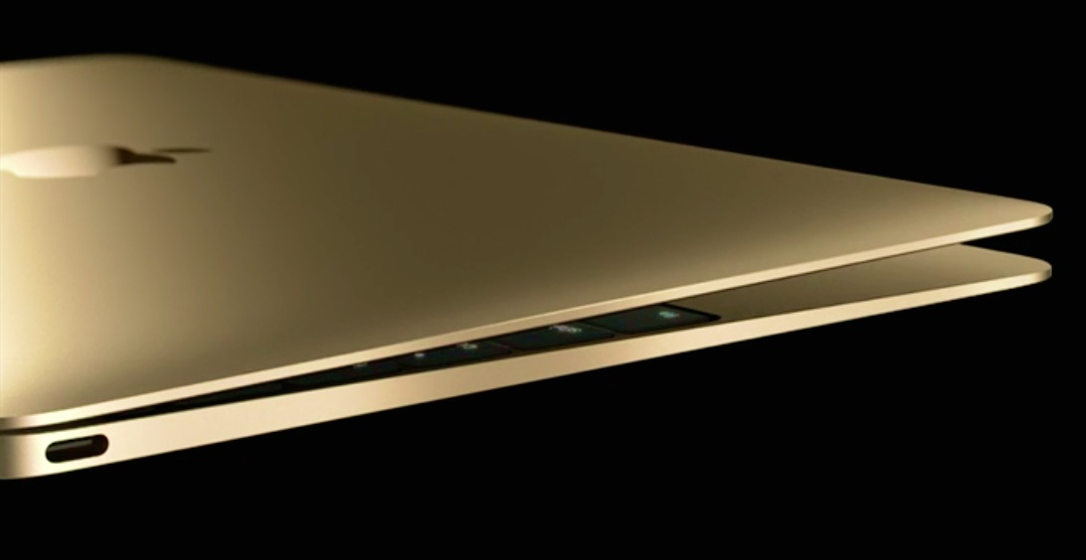
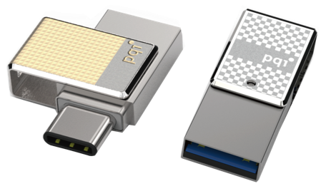
Connect 313
~ USB 3.1 Type-C™ OTG flash drive
Feature：
Expand new MacBook & Mobile memory
USB 3.0 COB patented technology
Rotate, cap-less design
Faster and reliable
Interface：USB 3.1 G1 Type-A & USB 3.1 Type-C™
Capacity：16/32/64/128GB
Dimensions：30.8 x 12.2 x 6.6 (mm)
Weight：4.8g
Warranty：2 Years
Compatible with the newest generation of MacBook

Slide 19
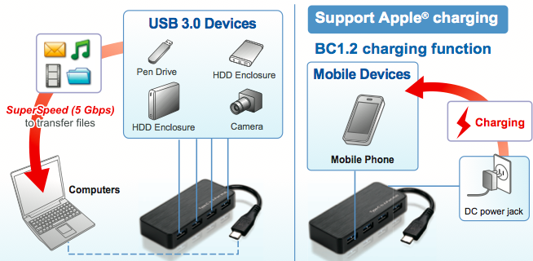
Connect 314
~ USB-C™ 4 Port Hub
Feature：
USB 3.0 Output Port x4
Type-C Input Port x1
Support auto switching between self-powered
Interface:
USB 3.0 Output Port x4
- Hub downstream link, USB 3.0 type C female x1, charging power up to 15W
- Hub downstream link, USB 3.0 type A female x3
USB 3.0 Input Port x1
- Host upstream link, USB 3.0 type C male
DC Power Jack x 1
Power Supply:
Self-Power
Switching power adapter
- Input: AC 100-240V / Output: DC 5V 4
Dimensions:91 x 40.5 x 16 (mm)
Weight:50g
Warranty:2 Years
OS Supported:Wndows® 7, Windows® 8, Windows® 8.1, Mac OS®

Slide 20
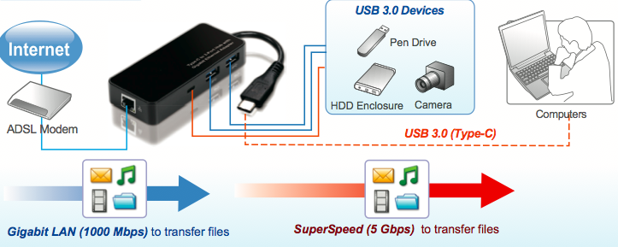
Connect 315
~ Type-CTM to 3-Port Hub with Gigabit Ethernet
Feature：
USB 3.0 Output Port x3
Type-CTM Input Port x1
Gigabit Ethernet Output Port
Support wake-on-LAN function
Support Green Ethernet
Support IEEE 802.3az(Energy Efficient Ethernet)
Support IPV4/IPV6 pack Checksum Offload Engine(COE) to reduce
Interface：
USB 3.0 Output Port x3
- Hub downstream link, USB 3.0 type C female x1, charging power up to 15W
- Hub downstream link, USB 3.0 type A female x2
USB 3.0 Input Port x1
- Host upstream link, USB 3.0 type C male
RJ-45 x 1 (Ethernet 10/100/1000M Gigabit):
- Complies with the Full-duplex with flow control
and Half-duplex with
backpressure operation
Power Supply：Bus-Powered
Dimensions：91 x 40.5 x 16 (mm)
Weight：50g
Warranty：2 Years
OS Supported：Windows® 7, Windows® 8, Windows® 8.1, Mac OS®

Slide 21
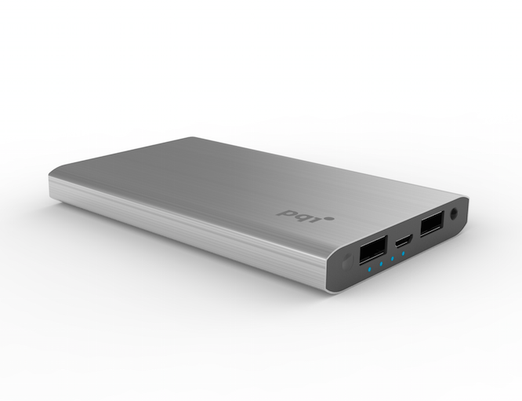
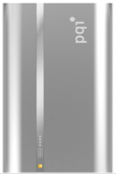
Power
Bank
Metallic type
Super Slim 5000mAh
Ultra Slim 10000mAh
6000mAh/9000mAh/12000mAh
Value
Embedded Micro USB style
QC 2.0 9000mAh
Wireless [Qi]
MFI certify power bank
Basic
6000e/12000e Power bank
5200mAh
9000T Power bank
7800mAh
15000 Power bank
Colorful design 5000C/10000C

Slide 22
2015 Metallic Power Bank

Slide 23
PQI Power 6000V
Perfect Dimension of Metallic Power Bank
One for All
Smart Capacity
Safe
support dual USB ports charging table and smart phone simultaneously
Perfect dimension of Metallic Power bank
Perfect weight.
Support charging i-Phone 6 2.4 Times/6+ 1.5 Times
Overcharging protection
Over-discharging protection
Short-circuiting protection
Current overflow protection
Electrical leakage protection
US$10 Million Products Liability Insurance
91 mm
USB 2.4A
Output
41.7 mm
Micro USB
2A input
Capacity:6000mAh Interface: USB x 2, Micro USB x 1
Input: 5V 2A Output: Total output 5V 3.9A
(5V1.5A/5V2.4A)
Charging cable included
USB 1.5A
Output

Slide 24
PQI Power 9000V
Perfect Dimension of Metallic Power Bank
One for All
Big Capacity
Safe
support dual USB ports charging table and smart phone simultaneously
Support charging i-Phone 6 3.6 Times/6+ 2.2Times
Overcharging protection
Over-discharging protection
Short-circuiting protection
Current overflow protection
Electrical leakage protection
US$10 Million Products Liability Insurance
58.7mm
95.7 mm
USB 2.4A
Output
USB 2A
input
USB 1.5A
Output
Capacity:9000mAh Interface: USB x 2, Micro USB x 1
Input: 5V 2A Output: Total output 5V 3.9A
(5V1.5A/5V2.4A)
Charging cable included

Slide 25
PQI Power 12000V
Huge capacity Metallic Power Bank
One for All
Huge Capacity
Safe
support dual USB ports charging table and smart phone simultaneously
Perfect dimension of Metallic Power bank
Perfect weight.
Support charging i-Phone 6 4.8 Times/6+ 2.9 Times
Overcharging protection
Over-discharging protection
Short-circuiting protection
Current overflow protection
Electrical leakage protection
US$10 Million Products Liability Insurance
96.7 mm
77.4mm
USB 2.4A
Output
USB 2A
input
Capacity:12000mAh Interface: USB x 2, Micro USB x 1
Input: 5V 2A Output: Total output 5V 3.9A
(5V1.5A/5V2.4A)
Charging cable included
USB 1.5A
Output

Slide 26
PQI Power 5000V
Ultra-slim power bank
for charging smartphones and tablets
One for All
Smart Capacity
Safe
support dual USB ports charging
Fast charging of Power bank
Ultra Slim Li-polymer Metallic Power bank
Support charging i-Phone 6 1.8 Times/6+ 1 Times
Overcharging protection
Over-discharging protection
Short-circuiting protection
Current overflow protection
Electrical leakage protection
US$10 Million Products Liability Insurance
USB 2.4A
Output
USB 1.5A
Output
USB2A
input
90.8 mm
72.2mm
Capacity:5000mAh Interface: USB x 2, Micro USB x 1
Input: 5V 2A Output: Total output 5V 2.4A max
(5V1A/5V2.4A)
Charging cable included

Slide 27
PQI Power 10000V
Ultra-slim huge capacity power bank
for charging smartphones and tablets
One for All
Huge Capacity
Safe
support dual USB ports charging
Fast charging of Power bank
Ultra Slim Li-polymer Metallic Power bank
Support charging i-Phone 6 3.5 Times/6+ 2.2 Time
Overcharging protection
Over-discharging protection
Short-circuiting protection
Current overflow protection
Electrical leakage protection
US$10 Million Products Liability Insurance
LED flashlight
USB2A
input
USB 1.5A
Output
USB 2.1A
Output
90.8 mm
13.5mm
72.2mm
Capacity:10000mAh Interface: USB x 2, Micro USB x 1
Input: 5V 2A Output: Total output 5V 3.6A max
(5V1.5A/5V2.1A)
Charging cable included

Slide 28
Micro USB embedded Power Bank- 9000R
5V 1.5A
output
5V 2.4A
output
5V 2A
input
Power Indicator

Slide 29
PQI Power 5200M
Support Android and Apple Cell phone simultaneously
Made for
iphone/iPod
Fast
Safe
Apple and Android Devices Compatible
Build in Apple lightning cable
Second USB cable support output and charging
5200mAh support 2.1A output and power bank fast Charging 2A input
Overcharging protection
Over-discharging protection
Short-circuiting protection
Current overflow protection
Electrical leakage protection
US$10 Million Products Liability Insurance
Fix Apple lightning cable
Power Indicator
USB Output
Power Indicator
Button
Micro USB
Input and output
Capacity:5200mAh Interface: USB x 1, Micro USB x 1
Input: 5V 2A Output: 5V 2.1A
Charging cable included

Slide 30
PQI Power 12000e
One for All
High Capacity
Safe
support dual USB ports charging table and smart phone simultaneously
Samsung/LG 18650 3000nAh*4
fully charge iPhone for 6 times
Overcharging protection
Over-discharging protection
Short-circuiting protection
Current overflow protection
Electrical leakage protection
US$10 Million Products Liability Insurance
Micro USB
2.5A input
USB 1A
Output
USB 2.5A
Output
Capacity:12000mAh Interface: USB x 2, Micro USB x 1
Input: 5V 2.5A Output: Total output 5V 3.5A
(5V1A/5V2.5A)
Charging cable included
Power Bank
fast charging

Slide 31
PQI Power 6000e
Micro USB
2.5A input
One for All
High Capacity
Safe
support dual USB ports charging table and smart phone simultaneously
Samsung/LG 18650 3000nAh*2
fully charge iPhone for 4 times
Overcharging protection
Over-discharging protection
Short-circuiting protection
Current overflow protection
Electrical leakage protection
US$10 Million Products Liability Insurance
USB 1A
Output
USB 2.5A
Output
Capacity:6000mAh Interface: USB x 2, Micro USB x 1
Input: 5V 2.5A Output: Total output 5V 3.5A
(5V1A/5V2.5A)
Charging cable included
Power Bank
fast charging

Slide 32
i-Power 13000- July MP
One for All
High Capacity
Safe
Work with iPhone, iPad and most smartphones & tablets
13000 mAh high capacity, fully charge iPhone for 5 to 6 times
Overcharging protection
Over-discharging protection
Short-circuiting protection
Current overflow protection
Electrical leakage protection
US$10 Million Products Liability Insurance
Power bank
for charging smartphones and tablets
Power Indicator
Button
Power Indicator
USB Output
Micro USB
Input
LG cells
inside
Example
Capacity: 13000mAh Interface: USB x 2, Micro USB x 1
Input: 5V 2A Output: 5V 3.1A Max
Charging cable included

Slide 33
i-Power 5200
One for All
High Capacity
Safe
Work with iPhone and most smartphones and digital cameras
5200mAh high capacity, fully charge iPhone for 3 to 4 times
Overcharging protection
Over-discharging protection
Short-circuiting protection
Current overflow protection
Electrical leakage protection
US$10 Million Products Liability Insurance
Power bank
for charging smartphones
Micro USB Input
Power Indicator
Power Indicator
Button
LG cells
inside
USB Output
Capacity: 5200mAh Interface: USB x 1, Micro USB x 1
Input: 5V 1A Output: 5V 1A
Charging cable included

Slide 34
i-Power 7800
One for All
High Capacity
Safe
Work with iPhone, iPad and most smartphones & tablets
7800mAh high capacity, fully charge iPhone for 5 to 6 times
Overcharging protection
Over-discharging protection
Short-circuiting protection
Current overflow protection
Electrical leakage protection
US$10 Million Products Liability Insurance
Power bank
for charging smartphones and tablets
Power Indicator
Button
Power Indicator
LG cells
inside
Micro USB
Input
Capacity: 7800mAh Interface: USB x 1, Micro USB x 1
Input: 5V 1A Output: 5V 1.5A
Charging cable included
USB Output

Slide 35
i-Power 9000T
All in one
Fast
Safe
Support Dual USB ports power bank
Unique design
Easily read LED indicator
Output 2.1A Fast Charging mobility device
Overcharging protection
Over-discharging protection
Short-circuiting protection
Current overflow protection
Electrical leakage protection
US$10 Million Products Liability Insurance
Power bank
for charging smartphones and tablets
Micro USB Input
USB Output
USB Output
Power Indicator
Power Indicator
Button
Capacity:9000mAh Interface: USB x 2, Micro USB x 1
Input: 5V 1A Output: 5V 2.1A
Charging cable included
Samsung Cell
inside

Slide 36
PQI Power 15000
For Tablet Power Bank
70cm
One for All
High Capacity
Safe
support dual USB ports charging table and smart phone simultaneously
Samsung 18650 3000nAh*5
fully charge iPhone for 6.6 times
Overcharging protection
Over-discharging protection
Short-circuiting protection
Current overflow protection
Electrical leakage protection
US$10 Million Products Liability Insurance
119cm
USB 2.1A
Output
USB 1A
Output
Capacity:15000mAh Interface: USB x 2, Micro USB x 1
Input: 5V 2A Output: Total output 5V 3.1A
(5V1A/5V2.1A)
Charging cable included

Slide 37
PQI Power 10000c
LED flashlight
One for All
High Capacity
Safe
support dual USB ports charging table and smart phone simultaneously
Ultra slim ATL Li-Polymer battery
fully charge iPhone for 5 times
Overcharging protection
Over-discharging protection
Short-circuiting protection
Current overflow protection
Electrical leakage protection
US$10 Million Products Liability Insurance
USB 2.1A
Output
USB 1.5A
Output
Capacity:10000mAh Interface: USB x 2, Micro USB x 1
Input: 5V 2A Output: Total output 5V 3.6A
(5V1.5A/5V2.1A)
Charging cable included

Slide 38
i-Power 5000C
Elegant
Fast
Safe
Colorful power bank
Unique design
Output 5V 2.1A Fast Charging mobility device
Overcharging protection
Over-discharging protection
Short-circuiting protection
Current overflow protection
Electrical leakage protection
US$10 Million Products Liability Insurance
Colorful power bank
for charging smartphones and tablets
LED flashlight
USB Output
Micro USB Input
Power Indicator
Power Indicator
Button
Capacity: 5000mAh Interface: USB x 1, Micro USB x 1
Input: 5V 1A Output: 5V 2.1A
Charging cable included
Li-polymer
battery inside

Slide 39
PQI Lightning cable

Slide 40
Mobility Roadmap
Type C cable
i-Cable Dongle
i-Cable
Metallic
C to C FF
Power cable
HDMI Dongle
DP Cable
C to C 2.0
Micro USB To Lightning
Gray/Sliver/Gold
July/2015
Mass Production
2015 Q1/Q2
2015 Q3~Q4
i-Charger
QC2.0 Charger
USB3.0 32~64G
UK/EU/KR/US type
_{MP}
_{Developing}
_{Planning}
July/2015
Notes:
₄₀
i-Cable metallic第一批已經被喀司口訂光了

Slide 41
Cable
High-end
Apple MFI Certified
Retractable cable
i-cable Metallic
Multi-Plug
Value
Du-Plug
Flat 20 Cable Ring
Mesh Cable
Car charger
with du-plug cable
Basic
Lightning Cable 100cm/180cm
Lightning to Micro USB Adapter

Slide 42
Metallic Lightning cable
Apple Certified
Durable
Classic color
MFI Certification
Support iPhone 6/6+/5/5S/5C, iPad 4, i-Pad Air, iPad Mini, and iPod 5+
Enhanced design
High quality manufacturing
Gray & Silver & Gold
Outstanding packaging
Flat cable resists tangling kinking
Reversible Standard USB
connector
- Allows to plug in any direction
Apple Style Color design

Slide 43
PQI i-dongle
Apple Certified Lightning to Micro USB Adapter
Apple Certified
Durable
Classic color
MFI Certification
Support iPhone 6/6+/5/5S/5C, iPad 4, i-Pad Air, iPad Mini, and iPod 5+
Connect to micro USB cables and compatible chargers
Ultracompact, durable design
Gray & Silver & Gold
Compatible with Apple device
Small size design
easily to carry

Slide 44
i-Cable 100/180
Apple Certified
Durable
Classic color
MFI Certification
Support iPhone 6/6+/5/5S/5C, iPad 4, i-Pad Air, iPad Mini, and iPod 5+
Enhanced design
High quality manufacturing
180 cm Black & White
100 cm Black & White & Blue &Pink
Apple Certified Lightning Cable
New narrow lightning connector – can still plug in iPhone with casing
Length: 100cm(Black / White/Blue/Pink)
/180cm (Black / White)
Interface: Apple Lightning x 1, USB x 1

Slide 45
i-Cable Flat 90
Apple Certified
Durable
Classic color Colorful
MFI Certification
Support iPhone 6/6+/5/5S/5C, iPad 4, i-Pad Air, iPad Mini, and iPod 5+
Enhanced design
High quality manufacturing
Blue /Pink/Purple
Apple Certified Lightning Cable
Flat cable resists tangling kinking
Reversible
Standard USB
connector
Length: 90CM
Interface: Apple Lightning x 1, USB x 1

Slide 46
i-Cable Du-Plug 90CM
Apple & Android
Durable
Classic & Colorful
MFI Certification
Support iPhone 6/6+/5/5S/5C, iPad 4, i-Pad Air, iPad Mini, and iPod 5+
Support Android phone and tablet
Enhanced design
High quality manufacturing
Black & White
Apple Certified Lightning Cable
+ Micro USB Cable for Android / DSC
Length: 15CM/90CM
Interface: Apple Lightning x 1, Micro USB x 1, USB x 1

Slide 47
i-Cable Multi-Plug
Apple & Android
Durable
Classic & Colorful
MFI Certification
Support iPhone 6/6+/5/5S/5C, iPad 4, i-Pad Air, iPad Mini, and iPod 5+
Support new and older Apple devices
Support Android phone and tablet
Enhanced design
High quality manufacturing
Black & White
Apple Certified Lightning Cable
+ Apple Certified 30-pin Cable
+ Micro USB Cable for Android
Length: 90CM
Interface: Apple Lightning x 1, Apple 30-pin x 1, Micro USB x 1, USB x 1

Slide 48
i-Cable Flat 20
Apple & Android
Durable
Classic & Colorful
MFI Certification
Support iPhone 6/6+/5/5S/5C, iPad 4, i-Pad Air, iPad Mini, and iPod 5+
Enhanced design
High quality manufacturing
Blue /Pink / Purple
Apple Certified Lightning Cable
+ Best for Power Bank charging
Length: 20CM
Interface: Apple Lightning x 1

Slide 49
i-Cable Mesh
Apple & Android
Durable
Classic
MFI Certification
Support Apple lightning devices
Enhanced design
High quality manufacturing
Black
Apple Certified Lightning Cable
Reversible
Standard USB
connector
Length: 90CM
Interface: Apple Lightning x 1

Slide 50
i-Charger
Handy
Fast
Safe
Stylish
Supports 12V-24V vehicle voltage
Dual USB ports, simultaneously charging 2 devices
2.1A Fast Charging
Built-in PPTC prevents damage caused by overvoltage and greatly increases the safety of the device
Black, Blue, Gold, Silver, Red
Car Charger
i-Charger for Car with dual plug
Interface: USB x 1 + Du-plug cable
Input: 12 – 24V Output: 5V 2.1A

Slide 51
i-Charger mini
Handy
Fast
Safe
Stylish
3.4A Charger
2 USB ports support charging smart phone and tablet charging simultaneously
Built-in PPTC prevents damage caused by overvoltage and greatly increases the safety of the device
White
3.4A output
US
EU
Interface: USB x 2
Input Voltage：100V-240V Output: 5V 3.4A
KR
UK
AU

Slide 52
Quick Charge
Less Time Charging. More Time Doing.

Slide 53
PQI Mobility accessory- Support QC 2.0

Slide 54
PQI Quick Charge vs. Power Bank & Mobile Device
 | Charger 5V 1A | Charger 5V 2A | QC Charger 9V 1.8A
9000QC 25% Capacity | 217 Minutes (3 HR 37 Min) | 85 Minutes (1 HR 25 Min) | 30 Minutes
9000QC 50% Charge | 281 Minutes (4 HR 41Min) | 133 Minutes (2 HR 13Min) | 64 Minutes (1 HR 4 Min)
9000QC 75% Charge | 375 Minutes (6 HR 15 Min) | 195 Minutes (3 HR 15 Min) | 119 Minutes (1 HR 59 Min)
9000QC 100% Charge | 506 Minutes (8 HR 26 Min) | 306 Minutes (5 HR 6 Min) | 233 Minutes (3 HR 53 Min)
86%
65%
77%
52%
68%
40%
54%
24%

Slide 55
QC 2.0 Power Bank & Wall Charger

Slide 56
i-Charger mini QC2.0
Spec:
Input: 90~265 VAC
Output: 5V2A, 9V1.8A,12V1.5A
interface: Micro USB
Micro USB Output QC2.0
Samsung
9V1.67A
Output:5V2A/9V1.8A/12V1.5A

Slide 57
Input Voltage 5V 2A, 9V 1.8A
Output USB A: 5V 2.4A/9V1.8A/12V1.35A
Output USB B: 5V/1.5A
Capacity: 9000mAh

Slide 58
LED Indicator
QC2.0 Indicator
Touch Switch
OutputQC2.0
Input QC2.0
Output
5V 1.5A

Slide 59
PQI Organization Bag
- can do customization according to different demands
Interior

Slide 60
PQI Organization Bag
- can do customization according to different demands
Elastic ribbon

