Slide 1
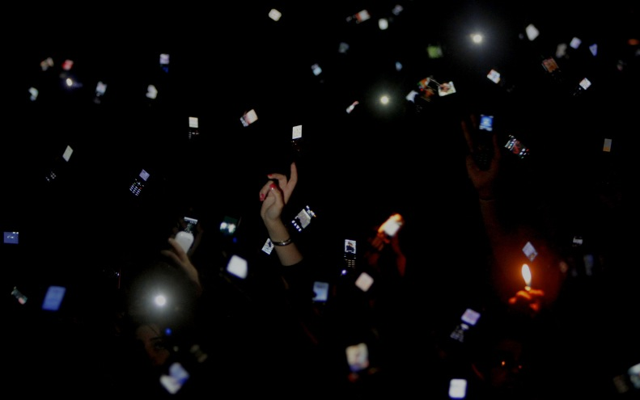

Connect 210 Sales Kit
5 in 1 HDTV Reader
Date: Oct.24, 2014

Slide 2
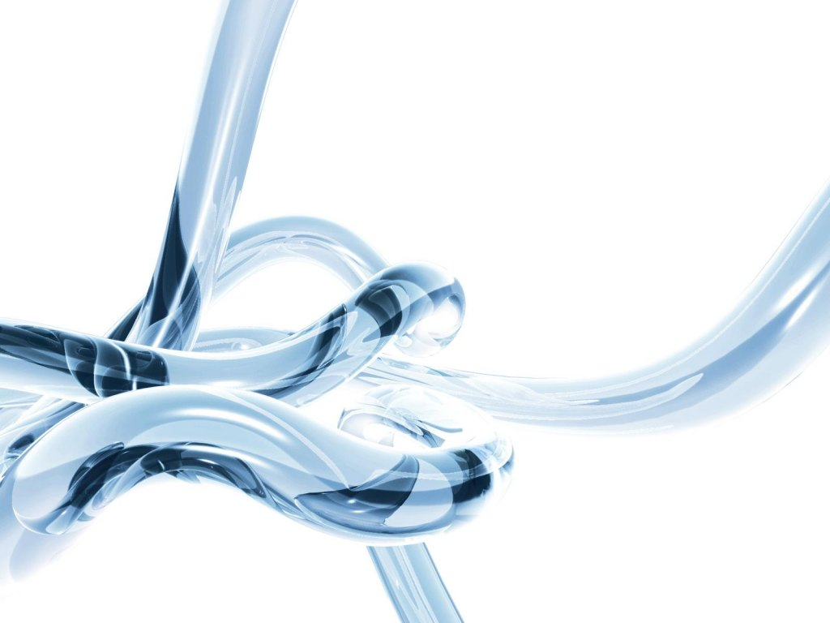


Slide 3
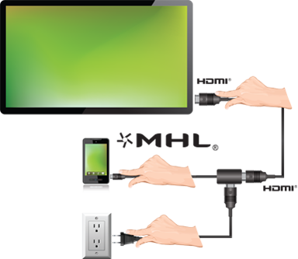
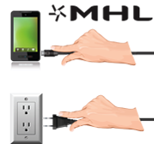

What is MHL?
MHL= Mobile High-Definition Link (行動高畫質連結技術)
One end of an MHL cable will plug into the micro USB port on your phone or tablet while the other will plug into an HDMI port on a television or monitor and your phone's screen will then be mirrored on the external screen.
Notes:
http://pulipuli.blogspot.tw/2012/11/mhl.html#postcata1409898001225_anchor4

Slide 4
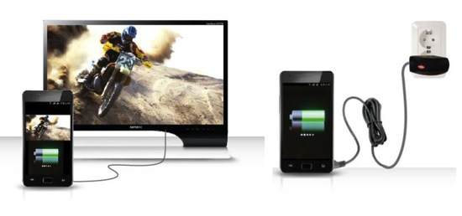
What is MHL Function?
With MHL
Without MHL
You can sync the mobile phone and television. At the same time, it is also charged.
You mobile phone is just charged.

Slide 5
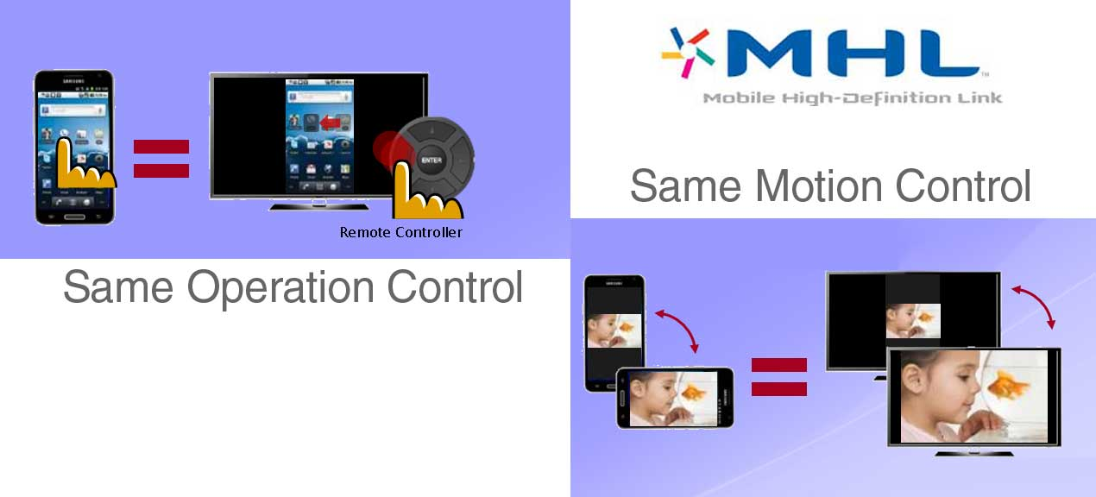
What is MHL Function?

Slide 6
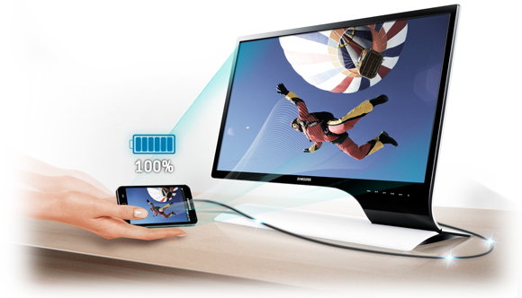
MHL Connectivity
Enhance viewing from mobile to monitor
With Mobile High-Definition Link (MHL), you can experience entertainment with full-size monitor luxury and higher-quality HD viewing. MHL lets you watch video and other content on the move, such as an Android smartphone and then lets you easily connect the mobile device to the monitor so you can finish your viewing in stunning HD.
Notes:
http://www.samsung.com/uk/student/product-displays.html

Slide 7
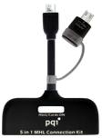
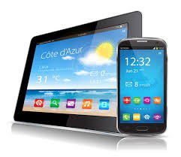


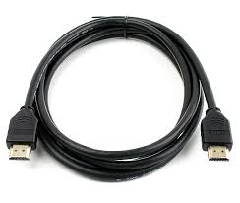

What do I need to use MHL?
＋
＋
＋
＋
microUSB
Mains Charger
PQI Connect210
(5 in 1 HDTV Reader)
Smartphone
or Tablet
HDMI
Cable
HDMI Display
(TV OR Monitor)
In order to use MHL, you will need the following:
The microUSB mains charger that came with your handset
The correct MHL adaptor for your handset
The MHL-enabled phone or tablet that you wish to connect to a larger display
A HDMI lead
The HDMI display that you wish to connect your smartphone to
Notes:
http://blog.clove.co.uk/2013/11/06/mhl/

Slide 8
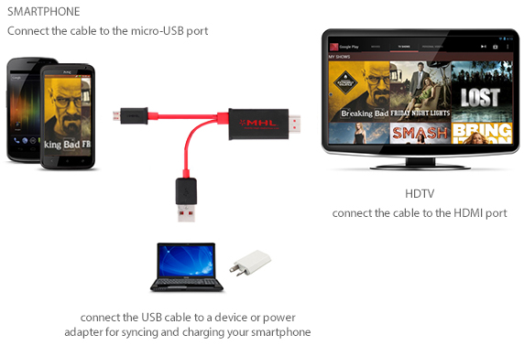





Product in action
MHL Adapter
100% Charge
Notes:
http://www.sonymobile.com/tw/support/faq/mhl-to-hdmi-adapter-im750/mhl-to-hdmi-adapter-im750/how-do-i-view-phone-content-on-a-tv-using-the-mhl-to-hdmi-adapter-1/

Slide 9

Connect 210
Product Overview

Slide 10
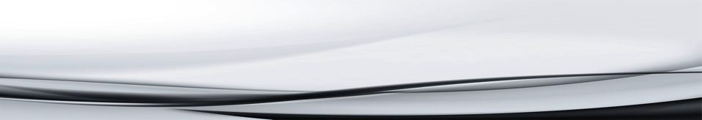
Appearance Description
micro-USB connector：
Connect Samsung mobile phone
LED indicator：(Power Button)
Indication of USB Host, SD\Micro SD and HDMI

Slide 11






Interface Description
5 connection function for MHL compatible mobile devices
SD slot：
Reads SD card
micro11Pin connector:
Connect S3 and Note 2
micro5Pin slot:
Micro 5P switch to Micro 11P
7
HDMI slot:
HDMI output
micro SD slot:
Reads Micro SD card
USB Female port:
Reads USB disk devices
5
micro USB slot:
When use HDMI output function, supply power to Connect210

Slide 12
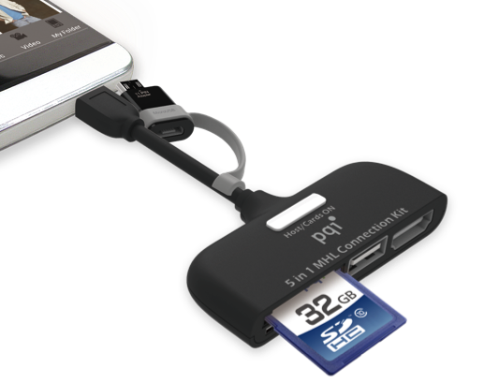
LED working status indicator
Orange : HDMI is in use
Red : USB HOST is in use
Blue : SD/Micro SD is in use

Slide 13
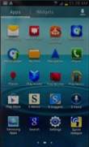
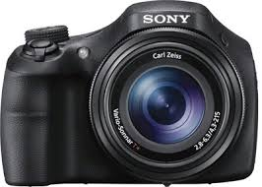

Using USB connectivity
Connecting a digital camera:
Connect the Connect210 micro USB connector to the smartphone micro USB female port, then connect the USB cable from the camera and press indicator button for about one second to start reading, at this time Connect210 indicator light is lit up with red.
Connecting a Pen Drive:
Connect the Connect210 micro USB connector to the smartphone micro USB female port, then connect the USB drive to the USB slot and press indicator button for about one second to start reading, at this time Connect210 indicator light is lit up with red.
<Note>
When using USB Host, don’t insert SD or microSD card.
<Note>
When using Digital Camera, don’t insert SD or Micro SD card.

Slide 14


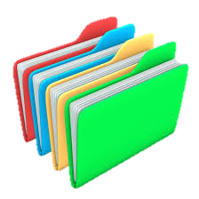
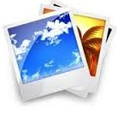


Using SD or micro SD card
Connect the Connect210 micro USB connector to the smartphone micro USB female port, then connect the SD card or micro SD card to the card slot and press indicator button for about one second to start reading, at this time Connect210 indicator light is lit up with blue.
<Note>
When using Memory card, don’t insert USB drive.
SD card
microSD card
（Anti plug）

Slide 15
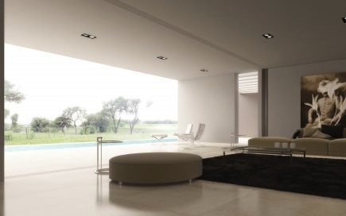
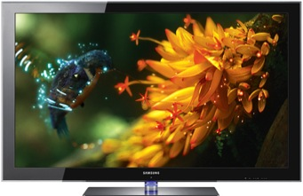


Using the MHL function
First, connect the Connect210 to the mobile. Then connect the HDMI to the Connect210 and to the HDTV. Connect the micro-USB cable to the Connect210 and the other end to any standard USB power source. At this point, the indicator light will lit up with orange. The HDTV will show the same screen of mobile synchronously after 10 seconds you can play videos or work on files from your mobile through a larger HD display.
<Note>
When connecting with the Galaxy S3 or Note 2, the micro-USB 11-pin adapter should be connected.

Slide 16
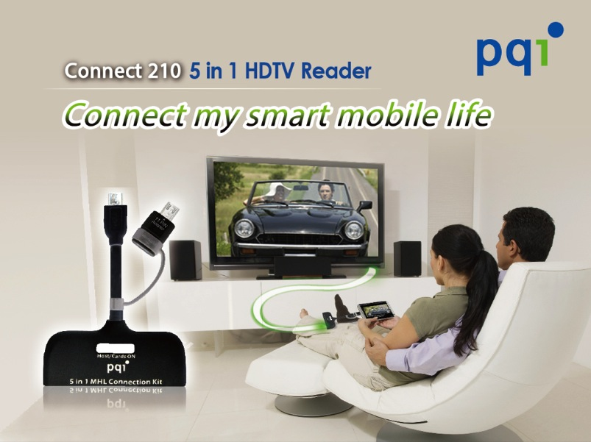
EDM

Slide 17
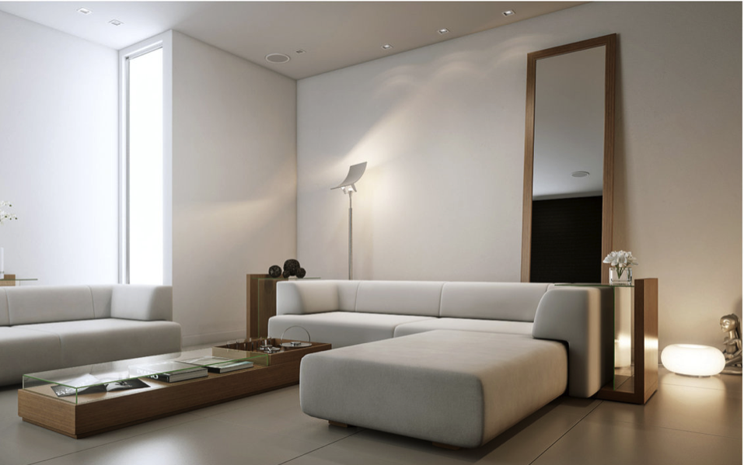
Specification
Interface: MHL / Host / SDHC / microSDHC /
microUSB （5 Pin microUSB： for HTC, SONY, NOKIA...etc. ）
11 Pin microUSB : for Samsung Galaxy S3/S4/S5/Note2/Note3, LG Nexus 4...etc.）
OS Supported: Supports mobile devices with OTG functions and compatible with Android 2.3.
Supports mobile devices with MHL functions and Android OS.
Dimensions: 67 x 24.5 x 10.9mm
Cable length: 60mm
Weight: 18.4g
Warranty: 1 Year
Other Information:
Visual resolution: Supports HD with 1920 x 1080 aspect ratio / 60Hz
Audio resolution: 192KHz compatible with 7.1 audio channel
Import images, videos and document files such as PDF, Word, Excel, etc. SD, micro-SD and USB host
micro-USB cable to link MHL-compatible devices to HDMI-compatible display
Charges device using micro-USB to USB

Slide 18

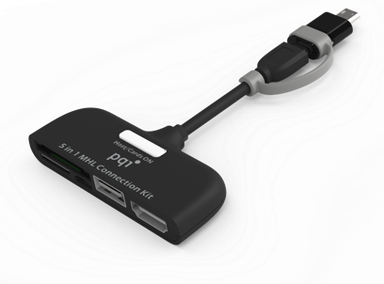
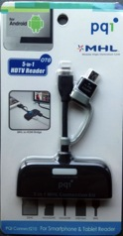
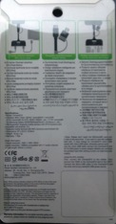
MP info.
MP Date: Oct. 22, 2014
Shipping info.
Packing Spec.
Main Player size (mm) | 67 x 24.5 x 10.9 mm
Qty/Ctn (pcs) | 80 pcs
Carton Size (cm) | 553*215*135 mm

Slide 19


