Slide 1


Slide 2


iConnect APP Function Intro
The File Manager for iPhone, iPad and iPod touch
Main Menu 2
Settings 3
File Browsing 4
Photo view 5
Document view 6
Video player 7
Music player 8
Edit Mode / Actions 9
File copy/move 10
Supported file types 11
1

Slide 3
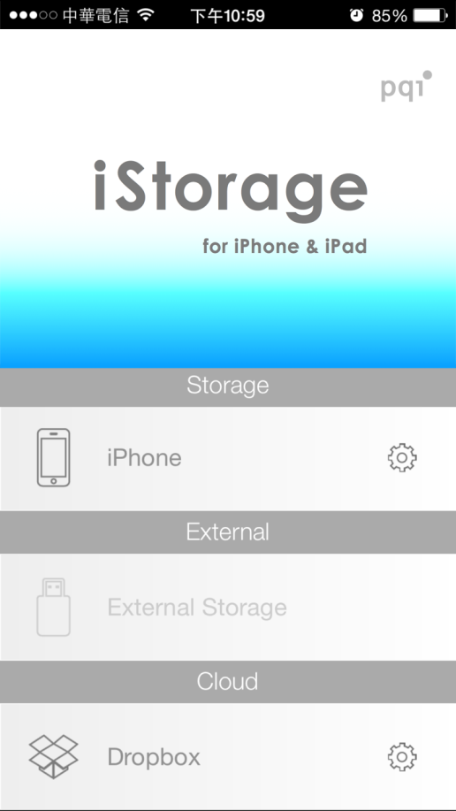
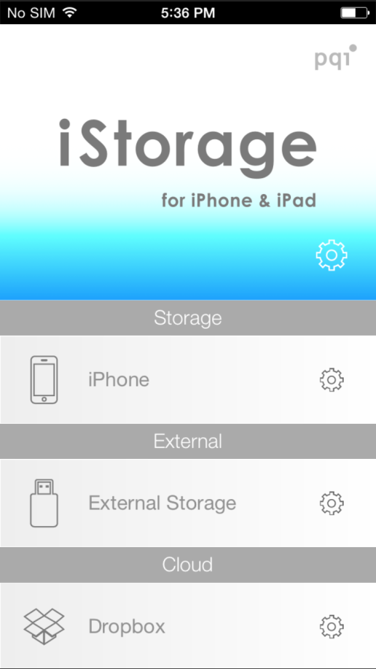
The Main Menu
The overview of all storage
Settings
Check Capacity
Not available when iStorage is not connected
Go to the storage within the APP
Go to iStorage
Go to Dropbox (Need to have an account)
2

Slide 4
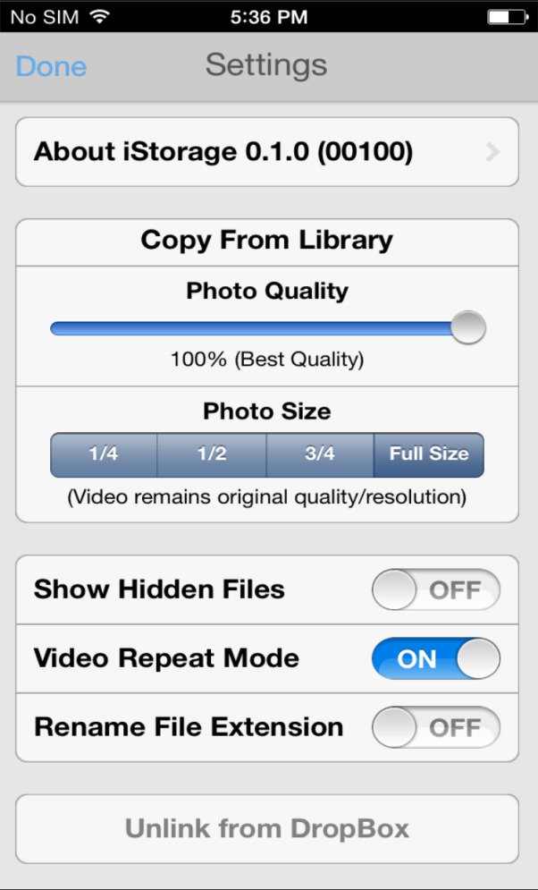
Settings
For detail configurations
A documents of legal notice and related contents
This is the dash board to select Photo Quality preference when export from Camera Rolls
To select hidden file appearance
To enable video play back loop
To enable Rename the file extension. (wrong file extension would leads to not being able to open)
When a Dropbox account is linked, you may unlink the account here
3

Slide 5
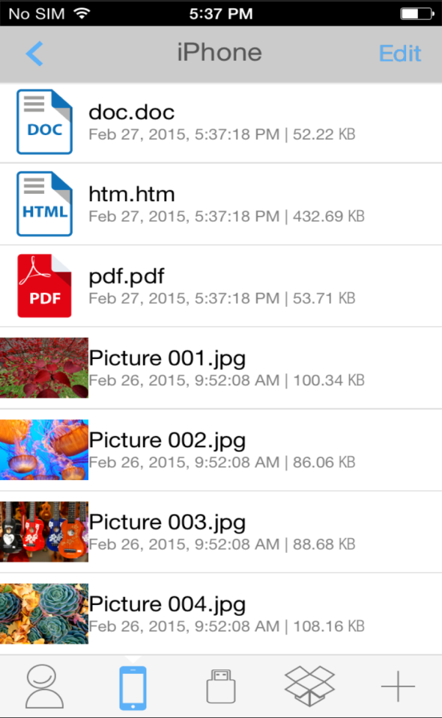
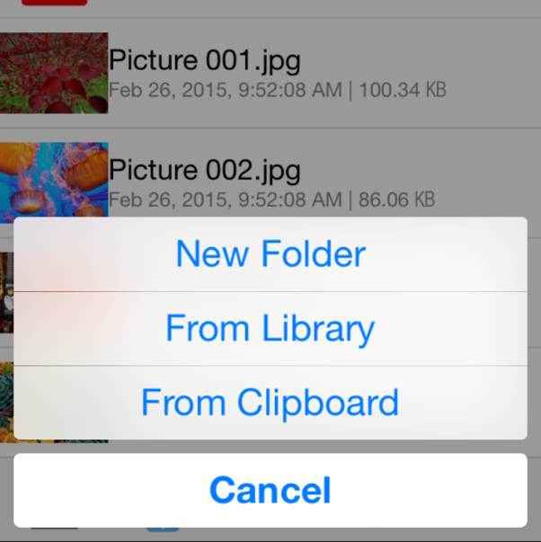
File Browsing
Basic view among Local, External and Cloud storage
Go back to previous level
Enter Edit Mode
Scroll up and down to discover mover
Switch between
Home Menu
iPhone (Local)
iStorage (External)
Dropbox
4

Slide 6

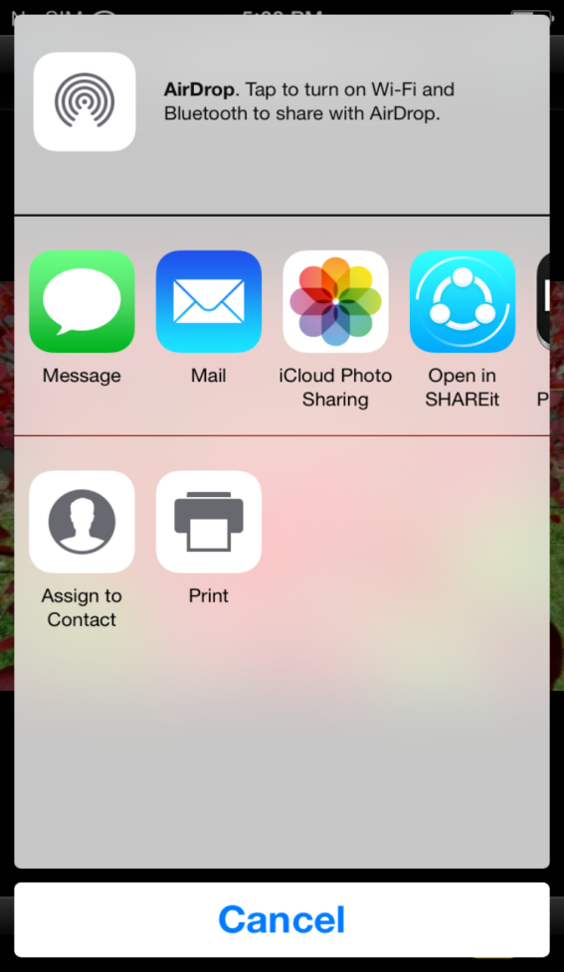
File Browsing
Photo view
AirDrop to enabled devices
Swipe left or right to browse more photos
Open-in files to enabled Apps
Print document to enabled printer
Save photo to Camera Roll
5

Slide 7
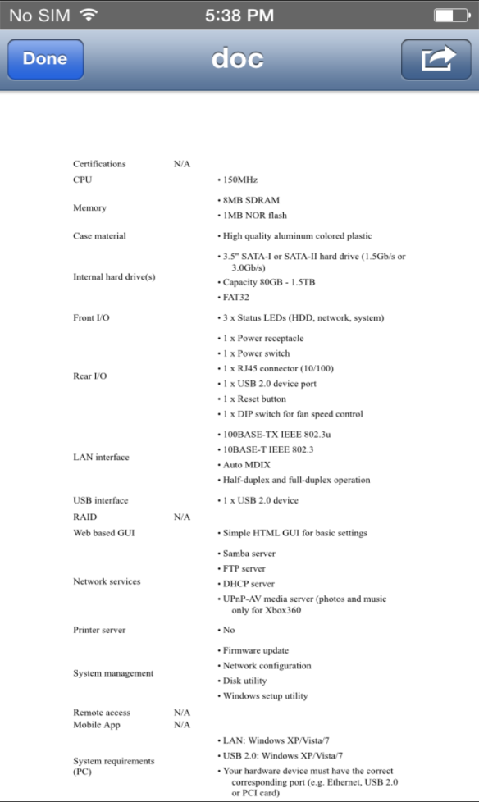
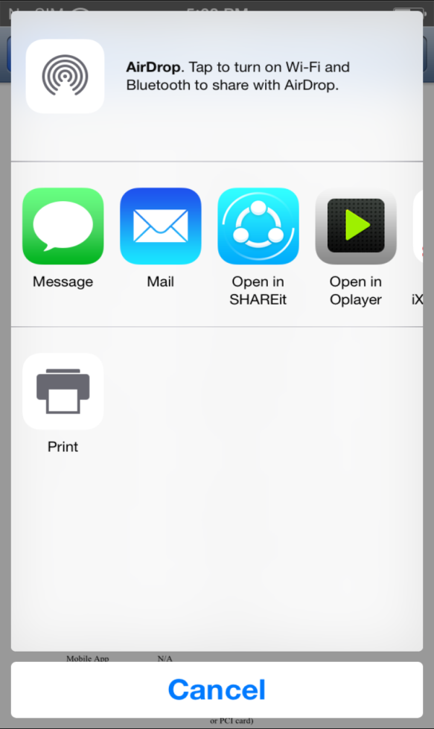
File Browsing
Documents view
AirDrop to enabled devices
Open-in files to enabled Apps
Print document to enabled printer
6

Slide 8

File Browsing
Video player
Progress Bar
Previous Pause/Play Next
Volume Control
7

Slide 9
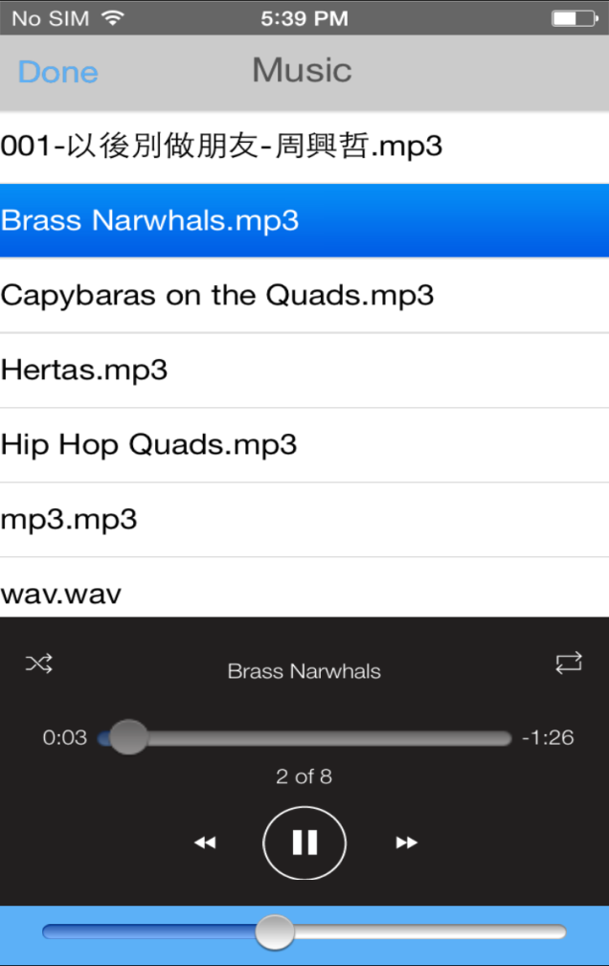
File Browsing
Music player
Tab on any audio file, the Music Player then generates a play list from all audio files within the same folder (sub-folder not included)
Scroll up and down to discover more
Music Play controls
Shuffle, Loop
Progress Bar
Previous, Play/Pause, Next
Volume, Alternative outputs
8

Slide 10
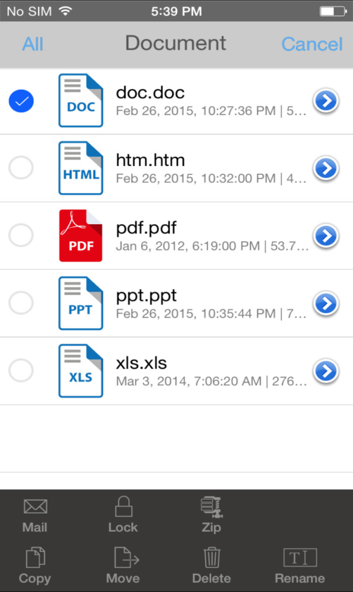

Edit Mode
Enables multi-file selection and more actions
Attach the file to a new email
Lock the file with a password
Compress the file into ZIP format
Rename the file
Copy the file to a different destination
Move the file to a different destination
Delete the file
Select single or multi files to perform actions below
9

Slide 11

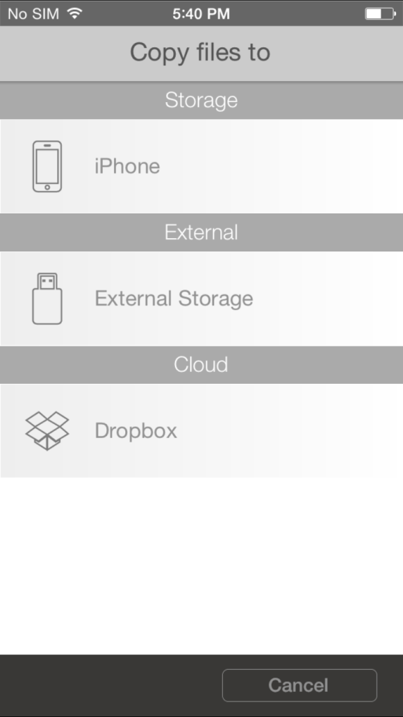
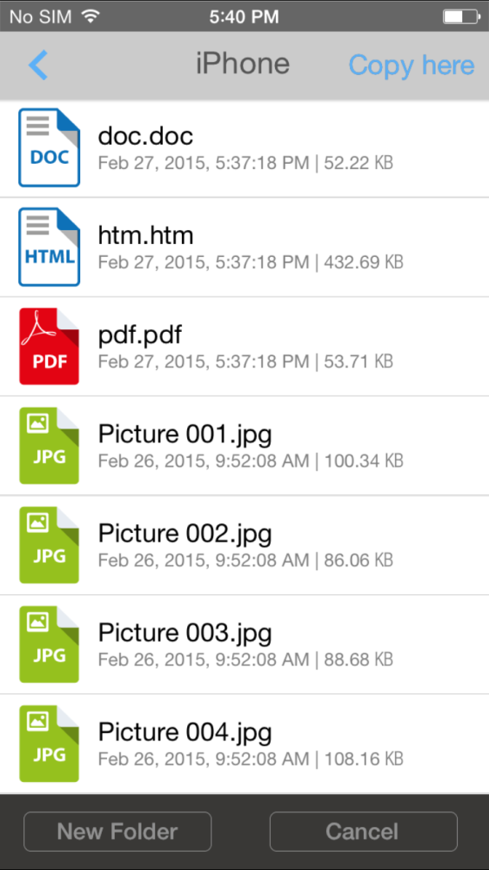
File Copy or Move
Simple flow to select file and destination to complete

Slide 12


